Slide 1
WELCOME!
To get set up and ready to go, please do the following:
Join using your computer audio
You can turn your video off if you’d like (but I’d like to see your face!). You’ll still be able to see the presentation.
You can turn on the chat function if you’d like (bottom middle of your screen options). Type a greeting if you want.

Slide 2
Zooming into the Future of Customer Service
Using Digital Tools to Assist Customers

Slide 3
Zoom Basics
Setting up an account
Zoom.us/signup
Click “Sign Up, It’s Free”
Verify your birthday
Enter your work email address, click “Sign Up”
Activate your account by going into your email inbox and clicking the link in the email from Zoom
Enter your information: Name and set up password; click “Continue”
Skip the “Invite Your Colleagues” step
Use the test meeting to familiarize yourself with some of the features

Slide 4
Scheduling a Meeting
Log in in to your account
Click “Schedule a Meeting”
Enter the pertinent information
Note: with a basic plan, meetings with 3 or more people are limited to 40 minutes
Set video, audio and meeting preferences
Click Save

Slide 5
Scheduling a Meeting (continued)

Slide 6
Even more Scheduling
Once saved, you have several options.
You can start the meeting immediately by clicking “Start this meeting”
You can add the meeting to various calendars (including Outlook)
You can invite people to join the meeting by copying and emailing the link
You can Delete, Edit or Save the meeting as a template

Slide 7
General Zoom Etiquette
Do not Zoom in the restroom
Be aware of what your camera picks up (background, pets, kids, SOs, etc.)
An example of what we DON’T want to happen
Be dressed professionally, at least as far as the camera can see
Use the mute feature when you’re not actively speaking
Try not to be afraid to break in if you have something important to add
If you are muted, and you want to interject, give the unmute feature a few seconds so your comments aren’t cut off

Slide 8
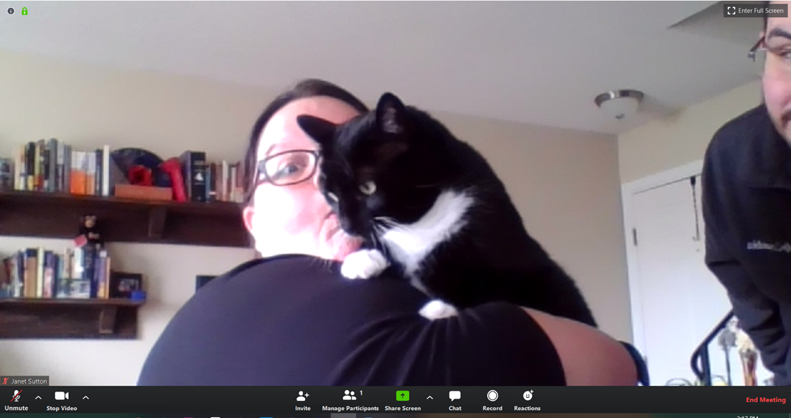
Handy In Meeting Features
Screen sharing- Hit the green “Share Screen” button and choose which screen you’d like to share
Virtual background-Should only be used if you have inappropriate/distracting background
Choose something professional
Google Search for “Blank Backgrounds”
Save the picture to your computer
Click the plus sign button in Virtual Backgrounds in the Video settings
Add Image from wherever you saved it
WFC Branded backgrounds are also available
Mirror my video & touch up my appearance
Personal favorites
Chat-Functions with the group and individually

Slide 9
Let’s practice sharing screens!
Make sure you don’t have anything of questionable content open!

Slide 10
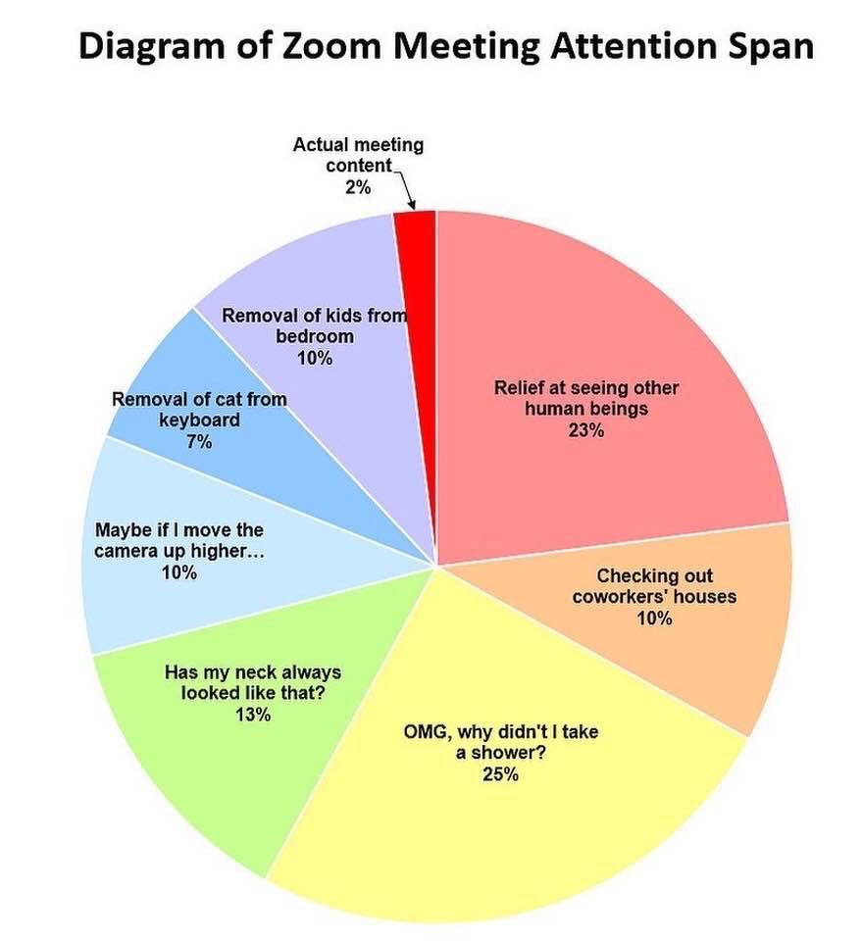

Slide 11
Questions?
You can shout them out or type them in the chat.

