Slide 1
Staying in Touch
Creating & Maintaining Contact with Customers In-person and Virtually

Slide 2
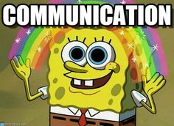
Communication Depends on Trust
Part of establishing trust is meeting the customer’s needs
Customers need to feel welcome, comfortable, and important
Customers need to be understood
Customers need assistance
Establishing trust and building rapport with customers takes communication & time, but there are some steps we can take to make it a little easier

Slide 3
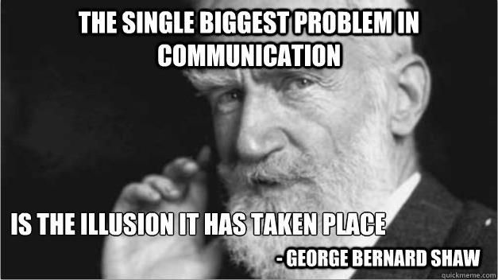
Poor Communication = Problems
We can all probably think of a time where poor communication slowed things down or just completely messed something up.
Sometimes, poor communication can hurt

Slide 4
OARS & Information Exchange
Communicate effectively (OARS)
Ask open ended questions to learn more about the customer & their goals; use “What” or “How”
Be affirming by recognizing their strengths, good intentions, and efforts rather than attempting to scare them into change, encourage change language
Reflectively listen by restating what the customer has said, allowing the customers to clarify the thoughts and feelings they’re expressing
Summarize the meeting through reflection, pull together information at the end of a meeting, suggest links between present and past, provide a “what else?” opportunity
Collaborate with your customers
Find out what information they need
Provide the needed information clearly
Offer small amounts of time to reflect
Acknowledge the freedom to disagree or ignore
Check back for understanding
Offer advice & make a plan WITH the customer
Establish clear, mutual expectations for implementing the plan

Slide 5
Maintaining Trust & Communication
Keeping in contact with customers depends on building mutual trust
Customers must trust us to keep their personal information safe
We must trust customers’ good will and desire to better themselves
Transitioning to or including the option for virtual services may complicate things a bit, but the expectation still exists that a working relationship with the customer is created and maintained
Discuss contact preferences with your customer at your initial meeting (get at least two options)
Utilize in-person or video call software for eligibility & IEP meetings at least, but attempt to make actual contact as much as possible (in-person, phone, video)

Slide 6
CM Contact Protocol Review
Case Managers (CM) must have contact with all customers on their case load at least once a month. It’s recommended that a “deadline” for the customer to reach out be formally established. Then, if the customer does not reach out, the CM will initiate contact via the preferred method.
Contact must be attempted at least three times each month for three months (90 days) using a variety of methods (primary & alternate phone numbers, email, written letter, etc.)
CMs should make contact attempts at a variety of days and times (More details in the Contact Protocol for Case Managed Customers)
After 60 days of no contact, CMs should send an exit warning letter to the customer
After 90 days, if no contact is made, the customer’s file should be submitted for closure of services due to lack of services
All contact attempts must be documented in Client Notes in KW; copies of any correspondence mailed to customer must be uploaded to M-Files

Slide 7
BSR Contact Protocol Review
BSRs must have contact with their assigned employers at least once every 6-8 weeks (30-40 business days)
This contact must include a two-way exchange and a provision of at least one Business Service (See BSR Service Definitions on the Intranet for more information)
BSRs should use a variety of methods to make contact with an employer
These contacts must be documented as “Contact Tracking” in KW
Employer accounts will be “deactivated by schedule” if there is no documented contact for 90 days

Slide 8
Content of Contacts (CMs)
Contact just for the sake of contact is pointless
CMs should use contact with customers to make sure they’re still working towards their goals, address any barriers that may have come up, and offer support and praise. Just “seeing if everything is okay” is not ideal
At a minimum, CMs should request information about training changes (is the customer still attending training, have they gained a certification) and employment information (gained/lost job, when, where, rate of pay, UI info if applicable)
Also, what supports do they need to be successful? How are we assisting them with these? Whether it is through services we can provide, or a referral to an outside agency, these must be documented
Utilize OARS to make quality contacts with customers

Slide 9
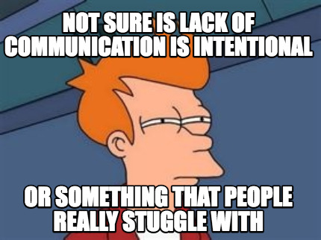
Content of Contacts (BSRs)
BSRs should make sure that their contact with employers is of high quality as well
Use OARS to assess the employer’s needs and to ensure they are aware of the full range of free services available to them including, but not limited to:
Job fairs
Skills assessments
On-the-job training
Recruitment assistance
Job postings
Registered Apprenticeship

Slide 10
Wrapping Up
Excellent communication depends on trust, and funnily enough, trust depends (at least in part) on communication
We should be working to create trust with our customers from day one
Use OARS and collaboration to help with communication and trust building
Protocols for minimum contact expectation are on the Intranet, be familiar with those as you interact with customers
CMs contact at least once a month
BSRs contact at least once every 6-8 weeks
Remember that contact for contact’s sake is pointless; focus on assisting customers and making each contact meaningful

