Slide 1
Senior Community Service Employment Program
A Program Overview

Slide 2
Start with Scenarios
Given what you know already, what would you do to help your assigned customer?
Are they a good fit for SCSEP? If so, what do you need to help them with in order to make that referral?
Consider what type of work assignment might be good for them. Come up with a couple of suggestions.
What barriers might the customer have and how might they be addressed?

Slide 3
SCSEP’s purpose
“Foster individual economic self-sufficiency and promote useful opportunities in community service assignments for unemployed low-income persons who are age 55 or older, particularly persons who have poor employment prospects, and to increase the number of older persons who may enjoy the benefits of unsubsidized employment in both the public and private sectors.” (20 CFR 641.120)

Slide 4
SO…
that means…

Slide 5
SCSEP helps participants become more independent by:
Providing employment training and job placements
Promoting useful community service activities
On-the-job training
Increased marketability through skill development
Paid, real-world experience
Reduced risk of social isolation
Networking opportunities
Access to job search assistance
Expands the agency’s ability to provide services
Provides experience, dependability and various qualifications to agency

Slide 6
Participant Services
Assessment services
Individual Employment Plan (IEP)
Annual physical exam (optional)
Supportive services
Paid community service experience
Placement at a host agency
Minimum wage, 20 hour/week position
Wage is subsidized by SCSEP
Assistance securing unsubsidized employment
Expectation that participant will be actively searching for unsubsidized employment during their placement

Slide 7
Benefits for Participants
SCSEP staff communicate and meet frequently with the participants and their host agencies
Problem solve with participants to overcome barriers
Provide relevant job leads
Provide training and workshop opportunities
Work hand-in-hand with host agencies to develop individualized training plans
Participants receive paid training hours each week for workshops and job fairs (as part of their 20 hour work week)
Are guaranteed support for their job search activities at their host agency
Agency provides job coaching

Slide 8
Host Agencies
Participants are placed at local non-profits and government agencies according to their interests, skills, and the needs of the organization. They go through a standard job interview process with the Host Agency determining whether or not to “hire” the participant.
Some Host Agencies:
Andover Senior Center
Child Start
City of Arkansas City Senior Center
City of Wichita Housing Dept.
Cowley Community College -Wellington
Dear Neighbor Ministries
Eagle Nest - Winfield
Episcopal Social Services – Breakthrough Club
His Helping Hands
Museum of World Treasures
Salvation Army
Starkey
United Methodist Open Door
Urban League
Wellington Public Library
Wichita Indochinese Center
Wichita Public Libraries
Workforce Alliance of South Central Kansas

Slide 9
Other SCSEP Facts
There is a time limit on program participation; participants must be actively job searching and might be moved periodically to another host agency to learn new employability skills
SCSEP participants are not considered employees of their host agency, but rather trainees
The placements are designed to develop and enhance the job skills needed for them to gain unsubsidized employment
Their placement at an agency cannot supplant an open job position for which they would normally hire someone, they can only be used to support existing positions
SCSEP wages are taxable and may affect SSI or SSDI income
SCSEP wages will not be includable income for SNAP or housing assistance

Slide 10
Eligibility Requirements
Participants must be
55 or older
Unemployed and eligible to work in the US
Must be low income, making less than 125% of Poverty Guidelines
SCSEP income guidelines can be a little hairy, you can check out SCSEP Income Guidelines on the Intranet or just give Chip a jingle if you have questions
Priority is given to those that
Are veterans or qualified spouses
Are 65 or older
Have a disability, limited English proficiency, low literacy skills, low employment prospects
Live in a rural area
Are homeless or at risk of homelessness
Have been recently released from incarceration

Slide 11
Referring Customers
SCSEP referrals require “next steps” to be completed before the referral form can be submitted
Customers must
Complete a 3 day job search (or have been observed to be unable to complete online applications)
Complete a resume
Have been approved for WIOA Basic Career Services

Slide 12
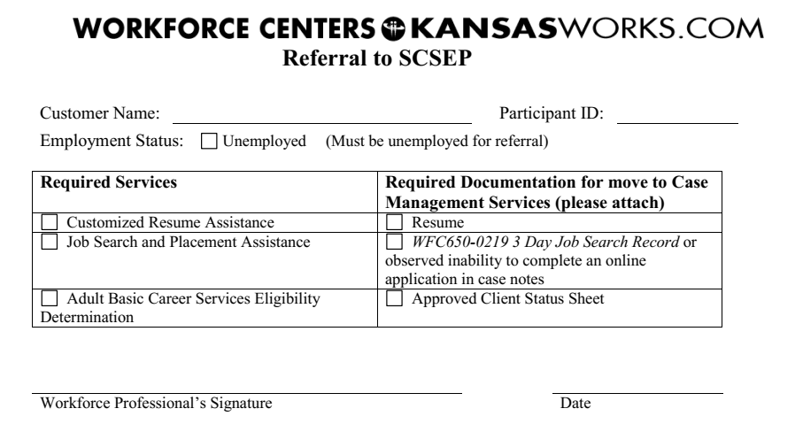
Referring Customers
SCSEP has its own referral form, WFC594-0417 Referral to SCSEP.
Each step has a corresponding service that must be entered into KANSASWORKS. Additionally, you’ll need to enter detailed case notes to document your referral journey.
Once all services and case notes have been entered, the referral form and the corresponding documentation can be submitted through M-Files.

Slide 13
Good Referrals
Need an income, but are unable to secure employment on their own
The job search should demonstrate this
Lack the current skills to obtain a job in their desired field
Might have significant job gaps
Veterans who meet the other requirements
People with lots of barriers

Slide 14
Not Good Referrals
Job Ready Individuals
Just left a job or have an extensive education that is still relevant to the current workforce
Retired and could get a job on their own but would rather do this and are bored
People who think they don’t have anything to learn; it is a training program
Just looking to get paid for volunteering
Quit a job to start SCSEP – NOOOOO!!!!

Slide 15
SCSEP Outcomes
Participants are strongly encouraged to apply for any job openings at their host agencies as they become available
Many of them have been hired in this manner and have served as success stories for the program
Open Door, Senior Services, The Salvation Army, The Workforce Alliance
Jean Jones, Sandra Holt, Mary Keller and others have been hired by a host agency because they became indispensable to the organization
SCSEP staff collaborates with the Business Team
Paid for PCA and CNA trainings that have resulted in jobs
180 Skills completion and hired by Spirit

Slide 16
Questions, comments, concerns?

