Slide 1
Priority of Service
Making sense of who gets served first

Slide 2
Priority of Service Overview
2 kinds of priority of service
Veterans & Spouse of a Veteran Priority of Service
Allows folks who identify themselves at the front desk to jump the line and be seen before others who might be waiting
Doesn’t require documentation to receive priority
WIOA Adult Program Priority of Service
Applies at the time of referral to individualized & training services (NOT BCSE)
Includes Veterans & spouses but also other priority categories
Requires documentation to complete eligibility process for training services
75% of the customers served with Adult funds must meet at least 1 Priority of Service category
The priority of service is provided for the Adult Program as follows
First, to veterans and eligible spouses who are included in at least one priority category
Second, to individuals who are not veterans or eligible spouses who are included in at least one priority category
Third, to veterans and eligible spouse who are not included in a priority category
Fourth, to all other individuals

Slide 3
Adult Priority of Service Categories
Low Income
Receives or is a member of a family who is receiving or in the past six months has received SNAP, TANF, Supplemental Security Income (SSI), or state or local income based public assistance
Member of a family with a total family income that does not exceed the poverty line or 70% of the lower living standard income level
Individual with a disability whose own income does not exceed the poverty line or 70% of the lower living standard income level but is a member of a family whose income does not meet the requirement
Homeless
Lacks a fixed, regular and adequate nighttime residence
Basic Skills Deficient
Unable to compute or solve problems or read, write, or speak English at a level necessary to function on the job, in the individual’s family, or in society

Slide 4
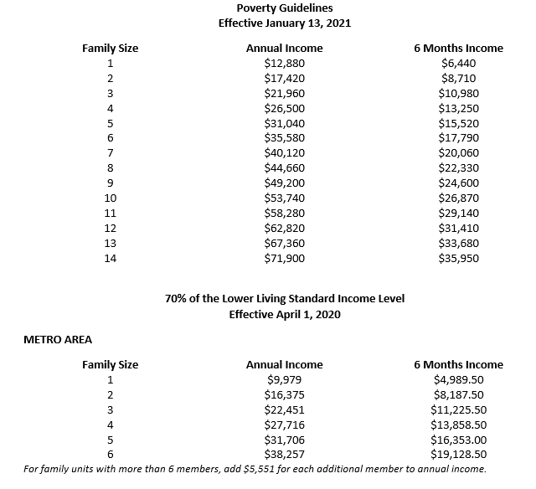
Determining Low Income
Use WIOA Income Guidelines to help (it’s on the Intranet!)
Look at the 6 month period prior to enrollment
Use either poverty level or LLSIL, whichever one is more beneficial to the customer
Guidelines are updated annually between March and May

Slide 5
Calculating Family Size
Family is defined (in WIOA) as:
2 or more persons related by blood, marriage, or decree of court who are living in a single residence and are included in one or more of the following categories
A married couple and dependent children
Parent or guardian and dependent children
A married couple
Family does not equal household
Consider only income information for people that are included in the definition of family
Customers with disabilities are always considered a family of 1
Only consider the income of the customer with the disability, not the other family members

Slide 6
More on Family Size
Customers who meet the following definition are also considered a family of one (have to meet all four)
14 years of age or older
Single, abandoned, separated, divorced, or widowed
Received less than 50% maintenance from the family
Not the head nor the spouse of the head of the household
Lets look at some examples!

Slide 7
Family Size Quiz
Mom, boyfriend, and a child living in a house. Boyfriend is not the father of the kiddo.
Family of 2
2 fathers and an adopted child living a house. Neither of the men is the biological father.
Family of 3 (assuming both gentlemen’s names are on the adoption paperwork)
17 year old customer lives with their parents and has a disability.
Family of 1

Slide 8
Family Size Quiz (cont’d)
18 year old mom of two living with her mom, dad, and sister. Customer pays half the rent and utilities on the house and assists with food. She pays for her own car, insurance, clothing, and other necessities.
Family of 3

Slide 9
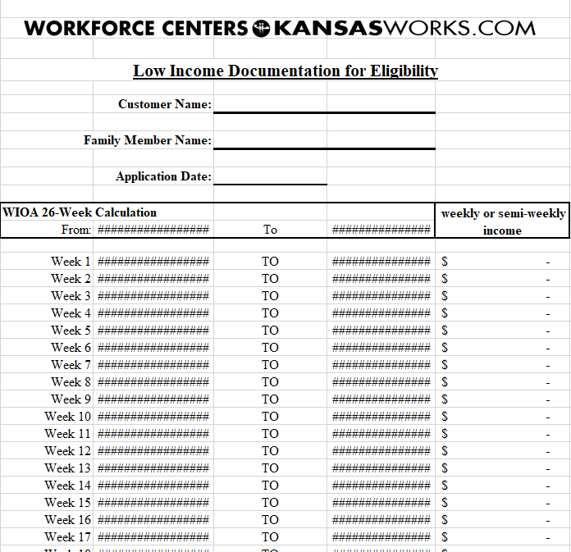
Calculating Income (Training Only)
Always use gross income (before taxes)
Documentation must clearly show the amount is gross, not net
Collect income information from all family members of working age
That’s everyone aged 16 and above
Complete one WFC070-0910 Low Income Documentation for Eligibility form per family member of working age per income source
If a family member works 2 jobs, they’d require 2 forms to be completed
Complete the form even if the family member has no income for the prior 6 months

Slide 10
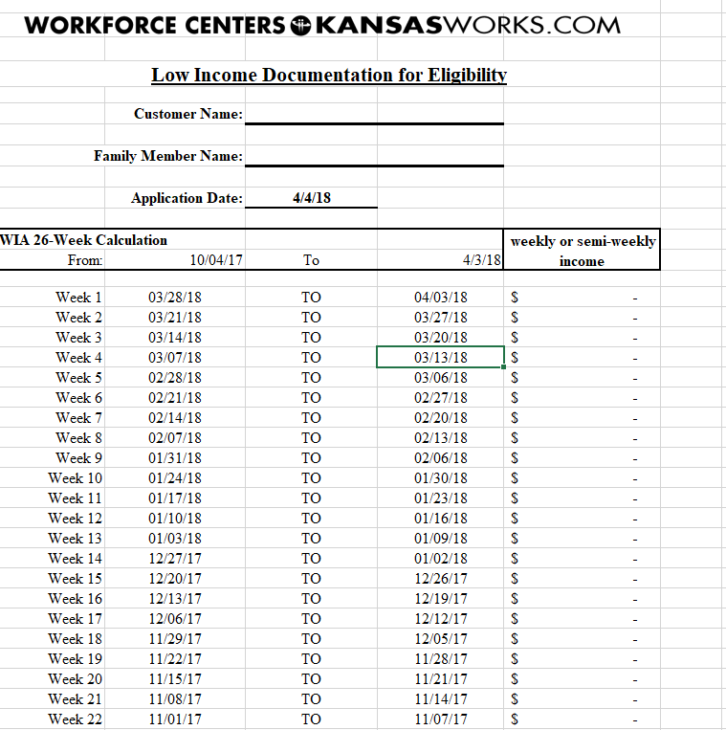
Calculating Income (cont’d)
The income increments on the Low Income Documentation form need to be the same as how they are received
Monthly, weekly, etc.
Must match the documentation provided
Record the amount next to the date range that includes when the income was received
Example: The pay range on a pay stub is from 3/18 to 3/31, but the date on the stub is 4/1.
Record the amount on the 3/28/18 to 4/3/18 line
Ensure income documentation is gathered for the full 6 months prior to application

Slide 11
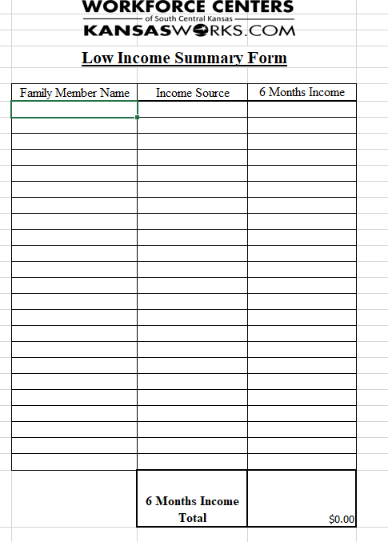
Further Calculation of Income
WFC645-0418 Low Income Summary Form must be completed per customer
Should have same number of lines completed as have low income documentation forms
Example: If there are 3 family members with one job each, there should be 3 Low Income Documentation Forms and 3 lines completed on the Low Income Summary Form

Slide 12
Eligibility and Beyond
Calculations of family size, income and other determinations are all part of the eligibility process
Documentation must be provided for all categories (including veteran/eligible spouse) if the customer is enrolling in training
There’s a whole slew of documents that can be provided to verify priority of service
You can find them on the WFC219-0611 Adult Program Training Priority of Service Verification
Use critical thinking skills when determining what documentation to use and whether or not it’s sufficient
The documentation needs to be tied to the customer or family member and provide the needed information
A Customer Statement is required for Adult Individualized Career Services
Basically self-attestation, but a little more formal

Slide 13
Quick Review on Referring to Adult
A customer who is interested/in need of training to gain or retain employment. Must also be aged 18 or older, eligible to work in the US, and compliant with Selective Service
For the Customer
WFC460-0414 Basic Career Services Customer Activities
These activities help the customer research what industries and/or specific jobs would interest and be a good fit for them before they begin the training process
WFC649-0219 7 Day Job Search Record
This is a tool to help keep customers organized. They don’t have to use it, but whatever they turn in must contain the information requested
For the staff making the referral
WFC495-0815 Referral to Adult Individualized Career Services
This form is the to-do list for the staff making the referral
WFC641-0218 Adult Program Priority of Service Verification
If you get mixed up, you can always look at the Program Quick Reference Guide for this information.

Slide 14
Questions or Concerns?

