Slide 1
Addressing Seasonal Farm Worker Safety Concerns
Workforce Centers of South Central Kansas
Wichita Kansas, August 19th, 2020
David K. McDonnell
Compliance Assistance Specialist
Occupational Safety and Health Administration

Slide 2
Topics
Role of OSHA and Function of CAS
Safety concerns for migrant & seasonal farm workers
Safety concerns for any workers
Worker rights
Whistle Blower Protection
How to make a referral to OSHA

Slide 3
OSHA’s Mission
With the Occupational Safety and Health Act of 1970, Congress created the Occupational Safety and Health Administration (OSHA) to ensure safe and healthful working conditions for working men and women by setting and enforcing standards and by providing training, outreach, education and assistance.

Slide 4
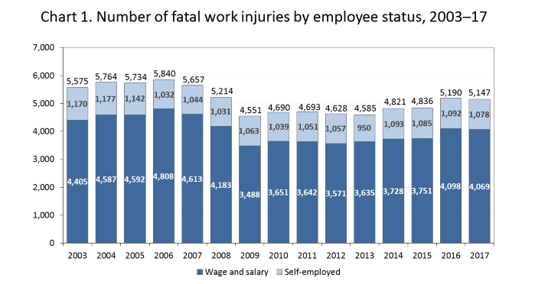
5,147 workers died from occupational injuries in 2017.
This number decreased slightly from the 5,190 in 2016.
Source: BLS
Notes:
The number of fatal workplace injuries has dropped considerably since OSHA was formed in 1970. Worker deaths in America are down-on average, from about 38 worker deaths a day in 1970 to 14 a day in 2016. Worker injuries and illnesses are down-from 10.9 incidents per 100 workers in 1972 to 2.9 per 100 in 2016.
Update for 2017: There were a total of 5,147 fatal work injuries recorded in the United States in 2017, a slight increase from 2016. Fatalities had increased from 2013 to 2016, according to the U.S. Bureau of Labor Statistics.

Slide 5
Inspections by Federal OSHA
In FY 2018, federal OSHA conducted 32,020 inspections.
State Plans conducted 40,993 inspections.
Notes:
This chart shows the number of inspections conducted by federal OSHA over the years.

Slide 6
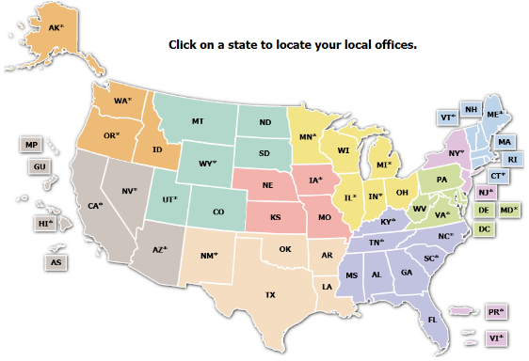
How OSHA is Organized
■ Region 1: Boston
■ Region 2: New York
■ Region 3: Philadelphia
■ Region 4: Atlanta
■ Region 5: Chicago
■ Region 6: Dallas
■ Region 7: Kansas City
■ Region 8: Denver
■ Region 9: San Francisco
■ Region 10: Seattle
Notes:
HOW OSHA IS ORGANIZED
OSHA is part of the Department of Labor.
The Agency has a central National Office, located in Washington, D.C.
OSHA also has 10 Regional Offices, which are located throughout the United States.
Each of these 10 regional geographic regions, which cover several states and contain multiple area offices.
Test Question:
22. OSHA must issue a citation within ___ of the occurrence of the violation: (TLO 5)
Three months
Six months
Twelve months
Five years
23. Citations are signed by the OSHA Area Director but they are not effective until they become a final order of: (TLO 5)
The Assistant Secretary for OSHA
The Occupational Safety and Health Review Commission
The Solicitor of Labor
The Secretary of Labor

Slide 7
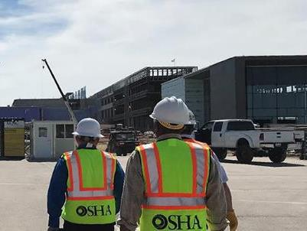
Regional and Area Office Functions
Inspections
Compliance Assistance
Outreach
Training
Penalty Collection
Abatement Assurance
Notes:
REGIONAL AND AREA OFFICE FUNCTIONS
Regional Offices include numerous Area Offices located within the Region, as well as specific programs (whistleblower protections, enforcement, cooperative and state programs, and administrative programs).
Regional and Area Office staff conduct a variety of activities. Their functions include:
investigating safety and health complaints,
performing inspections of worksites,
and conducting other activities, such as compliance assistance and training.
Test Question:
22. OSHA must issue a citation within ___ of the occurrence of the violation: (TLO 5)
Three months
Six months
Twelve months
Five years
23. Citations are signed by the OSHA Area Director but they are not effective until they become a final order of: (TLO 5)
The Assistant Secretary for OSHA
The Occupational Safety and Health Review Commission
The Solicitor of Labor
The Secretary of Labor

Slide 8

OSHA Enforcement
OSHA sets enforcement policy and targeted inspection programs, and responds to fatalities, catastrophes and complaints.

Slide 9
Inspection Types
Unprogrammed inspections
Programmed inspections
Notes:
OSHA conducts enforcement activities through two different inspection types – unprogrammed and programmed.
Programmed inspections specifically target the most dangerous workplaces and the most recalcitrant employers.
Unprogrammed inspections are initiated for several reasons, including worker complaints, referrals, employer reports and follow-up inspections.

Slide 10
Unprogrammed Activity
Imminent Danger
Fatality/Catastrophe
Complaints/Referrals
!
Notes:
Approximately 60% of OSHA inspections are for unprogrammed activity.
Unprogrammed activity has higher priority than programmed activity.
Unprogrammed activity includes imminent danger situations, fatalities and catastrophes, and complaints and referrals.
The highest priority goes to activity involving an imminent danger situation. This is where there is a high likelihood for a fatality or serious injury if the hazard is not addressed.
The next priority situation is where a worker has died or been hospitalized. OSHA would initiate an inspection to determine how the incident occurred, and to address the hazard before anyone else is killed or injured.
Inspections would also be conducted for formal employee complaints, or referrals, that involve serious hazards.
If a complaint involves a situation that is considered “other-than-serious”, OSHA would allow the employer to conduct a self-investigation and respond back with the results. The same process is used if the complaint comes from a former employee.
One type of employer-based referral comes from a severe injury report.
In 2015, OSHA expanded the list of work-related severe injuries that employers must report to the agency. Employers already had to report all work-related fatalities and hospitalizations of three or more employees within eight hours. Now, employers must also report all work-related in-patient hospitalizations, amputations, and loss of an eye to OSHA within 24 hours.
The Severe Injury Reporting program typically results in approximately 200 employer reports per week. OSHA inspects about one third of those reports.

Slide 11
The Inspection Process
Opening Conference
Walkaround
Closing Conference
Contest/Resolution
Notes:
OSHA’s on-site inspection begins with the compliance officer showing his or her credentials. This leads into an opening conference, which is a meeting between the OSHA inspector and the employer representative.
The compliance officer will explain why OSHA selected the workplace for inspection, and explain the inspection process. They will describe the scope of the inspection, walkaround procedures, employee representation, and the process for employee interviews.
Following the opening conference, the compliance officer and the representatives will walk through portions of the workplace covered by the inspection. This is called the walkaround. During the walkaround, they will look for hazards that could lead to worker injury or illness.
After the walkaround, the compliance officer will hold a closing conference with the employer and the employee representative to discuss the findings.
When an inspector finds violations of OSHA standards or serious hazards, OSHA may issue citations and fines.
A citation includes methods an employer may use to fix a problem and the date by which they must do so. Employers have the right to contest any part of the citation, including whether a violation actually exists. Workers only have the right to challenge the deadline by which a problem must be resolved.
Appeals of citations are heard by the independent Occupational Safety and Health Review Commission (OSHRC).

Slide 12
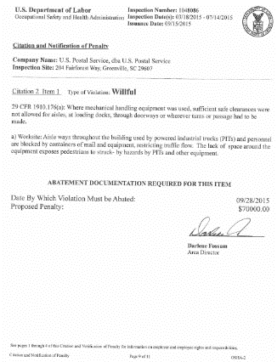
Violation Elements
Applicable Standard
Existence of Hazard
Exposure to Hazard
Employer Knowledge
Notes:
To prove that a violation has occurred, OSHA has to prove four elements:
--That an applicable standard exists
--That a hazard existed
--That an employee was exposed to the hazard, and
--That the employer knew, or should have known of the violation.
Citations are reviewed and issued at the Area Office Level. However, some types of citations or inspection scenarios might require a higher level of review.
OSHA has six months to issue a citation.

Slide 13
Violation Classification
Other-than-Serious
Serious
Repeated
Willful
Failure to Abate
Notes:
There are five main types of violations issued by OSHA. They are serious, other-than-serious, repeated, willful, and failure to abate. Let’s walk through each of those.
Other-than-Serious Violations
Other-than-Serious violations are issued when the most likely result from a hazardous condition would probably not be death or serious physical harm. These violations would, however, have a direct and immediate impact on the safety and health of employees.
Serious Violations
Serious violations are issued if it is probable that death or serious physical harm could result.
A determination must also be made that it is a recognized hazard. This is often determined on the basis of employer or industry recognition of the hazard.
Repeated Violations
Repeated violations are issued if an employer has been cited previously for the same or a substantially similar hazard.
This only applies if the previous citation has become a final order. A citation may become a final order when an employer does not contest the citation, or by a court decision or settlement.
The previous citation must have become a final order before the occurrence or observation of the second violation.
Willful Violations
Willful violations are issued when an employer has demonstrated either intentional disregard for the law, or plain indifference to worker safety and health.
Failure to Abate Violations
Failure to abate violations are issued when a previously cited violation has not been corrected.
However, if the violation was corrected, but later reoccurs, the subsequent violation is not considered a failure to abate. It would be deemed a repeated violation.
Test Question:
22. OSHA must issue a citation within ___ of the occurrence of the violation: (TLO 5)
Three months
Six months
Twelve months
Five years
23. Citations are signed by the OSHA Area Director but they are not effective until they become a final order of: (TLO 5)
The Assistant Secretary for OSHA
The Occupational Safety and Health Review Commission
The Solicitor of Labor
The Secretary of Labor

Slide 14
OSHA Penalty Levels: 2019
Type of Violation | New Maximum
Serious and Other-Than-Serious Posting Requirements | $13,260 per violation
Willful or Repeated | $132,598 per violation
Failure to Abate | $13,260 per day beyond the abatement date
www.osha.gov/penalties
Notes:
[Note to presenters: For a PPT on OSHA’s penalty levels, see the O drive at DCSP/CAS Resources/Presentations/Penalties/.]
OSHA adjusts its penalty levels annually to account for inflation.
This chart shows the adjusted penalty levels that took effect in 2019. See 84 Fed. Reg. 213 (Jan. 23, 2019).

Slide 15
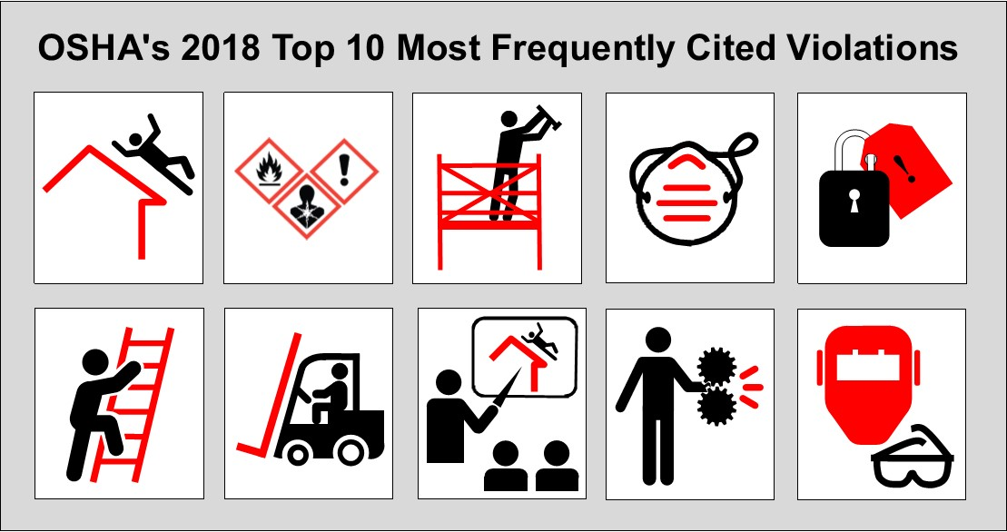
Top 10 Violations
Most frequently cited OSHA standards during FY 2018 inspections
Fall Protection – General Requirements (1926.501)
Hazard Communication (1910.1200)
Scaffolding (1926.451)
Respiratory Protection (1910.134)
Lockout/Tagout (1910.147)
Ladders (1926.1053)
Powered Industrial Trucks (1910.178)
Fall Protection – Training Requirements (1926.503)
Machine Guarding (1910.212)
Eye and Face Protection (1926.102)
www.osha.gov/Top_Ten_Standards.html
Notes:
[Note to presenters: More detailed PPTs on Top 10 Violations in various industries are available on the O drive under DCSP/CAS Resources/Presentations/Top 10 Violations/.]
This is a list of the top 10 most frequently cited standards following inspections of worksites by federal OSHA. OSHA publishes this list to alert employers about these commonly cited standards so they can take steps to find and fix recognized hazards addressed in these and other standards before OSHA shows up.

Slide 16

Compliance Assistance Specialists
Work out of OSHA’s Area Offices
Provide general information about OSHA’s standards and compliance assistance resources
Available for seminars, workshops, and speaking events
www.osha.gov/dcsp/compliance_assistance/cas.html
Notes:
OSHA’s Compliance Assistance Specialists (CASs) implement OSHA’s outreach initiatives around the country.
There is one CAS in most OSHA Area Offices. A directory of CASs is available on the OSHA webpage.
Note that CASs do not perform On-site Consultation visits. To request On-site Consultation assistance, contact your state On-site Consultation Project.

Slide 17
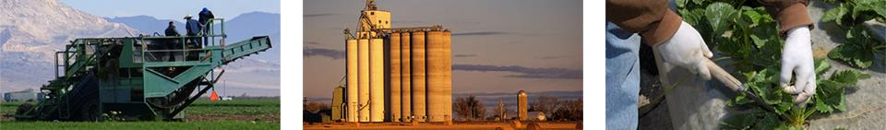
Agricultural Operations -
Hazards and Controls

Slide 18
Focus Four Hazards
Fall from
Caught in or between
Struck by
Electrical

Slide 19
Zoonotic Diseases
Agricultural workers may be exposed to animals that can transmit diseases.
Zoonotic diseases, or zoonoses, are diseases that can be transmitted from vertebrate animals to humans. Zoonoses are caused by bacteria, protozoa, fungi, viruses, parasites or prions, which are often part of an animal's natural flora (i.e., microorganisms that live in and on the animal) but are able to cause disease in humans. Infections can result from direct contact with animals or their products such as manure or placenta. Direct transmission can also occur through consumption of animal products (e.g., raw meat, raw milk, etc.) or through an animal bite. Humans can also become indirectly infected by contact with contaminated soil, food, or water. Farmers, ranchers, veterinarians, slaughterhouse workers, and other agricultural workers have a higher risk of contracting zoonoses because of their close contact with animals.

Slide 20
Grain Bins and Silos
Grain Bins and Silos
While safety issues surrounding grain bins and silos are sometimes overlooked on farms, they pose many dangers. Farmworkers are exposed to suffocation or engulfment hazards when working with grain bins and silos, as well as grain dust exposures and explosions. OSHA issued a Hazard Alert and an illustrated hazard wallet card explaining the dangers of working inside grain storage bins.
Suffocation can occur when a worker becomes buried (engulfed) by grain as they walk on moving grain or attempt to clear grain built up on the inside of a bin. Moving grain acts like "quicksand" and can bury a worker in seconds. "Bridged" grain and vertical piles of stored grain can also collapse unexpectedly if a worker stands on or near it. Additional information on safety and health issues associated with grain handling, such as personal protective equipment, use of lifelines, lockout/tagout, and training is located on the OSHA Grain Handling Safety and Health Topics Page.

Slide 21
Hazardous Equipment and Machinery
Farmworkers routinely use knives, hoes, and other cutting tools; work on ladders; or use machinery in their shops. However, these simple tools can be hazardous and have the potential for causing severe injuries when used or maintained improperly.
All tools should be maintained in good condition and used according to the manufacturers' instructions.
Power tools must be properly grounded or double insulated and all guards or shields must be in place.
Farmworkers should wear the proper personal protective equipment (PPE) and make sure that clothing has no strings or loose ends that could be caught by machinery. Long hair should be tied back to prevent entanglement.
In addition, shops should be well lit and have clear walkways to eliminate slips, trips and falls.

Slide 22
Heat
Heat-related illness. HEAT ILLNESS CAN BE DEADLY. Every year, thousands of workers become sick from exposure to heat, and some even die. These illnesses and deaths are preventable.
Workers exposed to hot and humid conditions are at a high risk of heat illness, especially if they are doing heavy work tasks or using bulky protective clothing and equipment. New workers may also be at greater risk than others if they have not built up a tolerance to hot conditions. Employers must take steps to help workers become acclimated.
Prevention. Heat-related illnesses, while potentially deadly, are easily preventable. When working in hot conditions, remember "WATER, REST, SHADE." Drink water every 15 minutes, even when not thirsty. Wear a hat and light-colored clothing. Rest in the shade. Be sure to watch out for fellow workers and know your location in case you need to call for assistance. Get help right away if there are any signs of illness

Slide 23
Ladders and Falls
OSHA's Fall Protection topics page and the National Institute of Occupational Safety and Health's Fall Injuries Prevention in the Workplace site provide general information on different types of fall protection. The following resources provide fall protection guidance for farm workers and employers:
Fall Prevention in the Agriculture Sector
Guidance note: Falls prevention in the agricultural sector

Slide 24
Musculoskeletal Injuries
Workers in agricultural operations for both crop and animal production typically use repetitive motions in awkward positions and which can cause musculoskeletal injuries.
Ergonomic risk factors are found in jobs requiring repetitive, forceful, or prolonged exertions of the hands; frequent or heavy lifting, pushing, pulling, or carrying of heavy objects; and prolonged awkward postures. Vibration and cold may intensify these conditions.
New technology may reduce some types of ergonomic injuries but increase others. For instance, while dairy farmers have traditionally been at a higher risk for developing osteoarthritis of the knee, more recent research has shown new technology used in milking has resulted in a shift in musculoskeletal disorders to the shoulders, hands and arms.

Slide 25
Noise
Thousands of workers every year suffer from preventable hearing loss due to high workplace noise levels, and research has shown that those who live and work on farms have had significantly higher rates of hearing loss than the general population. In fact, farming is among the occupations recognized as having the highest risks for hearing loss.
Tractors, forage harvesters, silage blowers, chain saws, skid-steer loaders, grain dryers, squealing pigs and guns are some of the most typical sources of noise on the farm. Studies suggest that lengthy exposure to these high sound levels have resulted in noise-induced hearing loss to farmworkers of all ages, including teenagers. Hearing loss is not as dramatic nor as sudden as an injury from a tractor overturn or machine entanglement, but it is permanent

Slide 26
Pesticides and Other Chemicals
Pesticides and Other Chemicals
Pesticide exposure. Pesticides pose risks of short- and long- term illness to farmworkers and their families. Workers who mix, load or apply pesticides (known as pesticide handlers) can be exposed to toxic pesticides due to spills and splashes, defective, missing or inadequate protective equipment, direct spray, or drift. Workers who perform hand labor tasks in areas that have been treated with pesticides face exposure from direct spray, drift or contact with pesticide residues on the crop or soil.

Slide 27
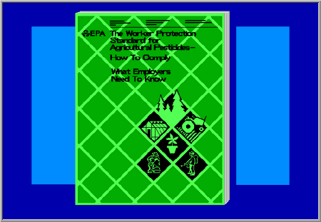
Notes:
These are the basic things the Worker Protection Standard requires employers to do. In short, it says you must ...

Slide 28

Notes:
Inform workers and handlers of the things they need to know about the pesticides that are being used at their place of work, and where and when to avoid exposure ...

Slide 29
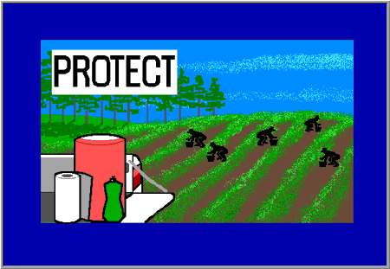
Notes:
Protect workers and handlers against pesticide poisonings and injuries -- for example, by providing them with personal protective equipment and giving them well-equipped places where they can wash pesticides off their skin ...

Slide 30
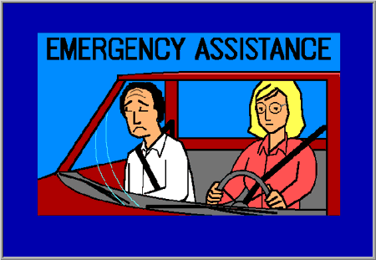
Notes:
and provide emergency assistance to workers and handlers in case an accident does happen.

Slide 31

Notes:
You may assign an employee to carry out these duties -- but as the employer, you are responsible for making sure that all your employees receive all the protection the Worker Protection Standard requires.

Slide 32

Notes:
If you are the owner of an operation that produces agricultural plants, you and members of your immediate family are exempt from some of the requirements of the Worker Protection Standard -- but you should protect yourself and your family as fully as you would an outside employee.

Slide 33
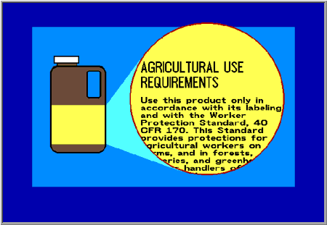
Notes:
The Worker Protection Standard is much too long to be printed in full on a pesticide label, but the labels of most agricultural pesticides will refer to it and tell you that you must follow its requirements. You will be misusing the pesticide if you do not comply with the parts that apply to you.

Slide 34

Notes:
Read each label carefully. If the label directions for the product you are using differ from the Worker Protection Standard requirements on any point, obey the label -- it is your guide to safe and legal use of the pesticide.

Slide 35
Notes:
This has been only a brief overview of EPA's Worker Protection Standard. The best way to learn exactly what the Standard requires and what you must do to comply is to get a copy of EPA's manual "Worker Protection Standard for Agricultural Pesticides -- How To Comply". It will tell you everything you need to do to be in full compliance.

Slide 36
Respiratory Distress
Respiratory Distress
Respiratory hazards. Respiratory hazards. Respiratory hazards in barns, manure pits, machinery and silos range from acute to chronic air contaminants. Farmworkers' most common respiratory hazards are bioaerosols, such as organic dusts, microorganisms, and endotoxins and chemical toxicants from the breakdown of grain and animal waste. Inorganic dust, from silicates in harvesting and tilling, is prevalent but less significant

Slide 37
Unsanitary Conditions
Unsanitary Conditions
The lack of drinking water, sanitation facilities and/or handwashing facilities can lead to many health effects. Farmworkers may suffer heat stroke and heat exhaustion from an insufficient intake of potable water, urinary tract infections due to urine retention from inadequate availability of toilets, agrichemical poisoning resulting from lack of handwashing facilities, and infectious and other communicable diseases from microbial and parasitic exposures.
The Field Sanitation standard (1928.110) applies to any agricultural establishment where eleven (11) or more workers are engaged on any given day in hand-labor operations in the field. OSHA standards require covered employers to provide: toilets, potable drinking water, and hand-washing facilities to hand-laborers in the field; to provide each worker reasonable use of the above; and to inform each worker of the importance of good hygiene practices

Slide 38

Heat Illness Prevention
Heat illness sickens thousands and results in the deaths of dozens of workers each year
Campaign educates employers and workers on danger of working in heat
Resources include OSHA-NIOSH heat safety app
Informal launch is (“Don’t Fry Day” – Friday before Memorial Day)
www.osha.gov/heat

Slide 39
Vehicle Hazards
Vehicle Hazards
Proper operation of farm vehicles can reduce accidents, injuries and fatalities in agricultural operations.
General vehicle safety
Vehicle operation
Do not allow passengers to ride in the bed of the vehicle.
Remove persons not involved in the activity from the site.
Shut off vehicle for refueling.
Park the vehicle whenever there is no driver inside, so that the motor is shut off, the brakes are engaged, the transmission is in park-lock or in gear, the keys are removed, and the attachments are disengaged.
All farm equipment traveling on any roadway should be equipped with an approved Slow Moving Vehicle (SMV) emblem. Emblems should be clean and in good shape.
Use a standardized system of hand signals to communicate when noise and or distance does not allow for verbal communication.
Falling Object Protective Structures (FOPS) should be installed on equipment where the user runs the risk of being struck by falling debris.
Never tow an implement that is improperly hitched.

Slide 40
Vehicle Hazards cont.
Vehicle Storage
Store away from structures housing livestock-to reduce the likelihood of fire.
Do not store with fuel storage tanks.
Do not store with debris.
Ensure that electrical lines are high enough for vehicles to pass below.
Ensure there is an easy exit from the storage structure.
Ensure the storage structure is lockable.
Ensure the floor surfaces are smooth and clean.
Remove keys from all vehicles.
Do not allow non-employees or children into storage structures

Slide 41
Vehicle Hazards Cont.
Rollovers
The OSH Act requires an approved Roll-over Protective Structure (ROPs) for all agricultural tractors over 20 horsepower that were manufactured after October 25, 1976, and which are operated by a hired worker. See 1928.51(b)(1). See also the National Institute for Occupational Safety and Health page on affordable ROPs and Science Blog, discussing the National ROPS Rebate Program (NRRP) that is run by the National Tractor Safety Coalition.

Slide 42
Vehicle Hazards Cont.
Tractor hazards
Dangers exist from improperly hitching a tractor, using Skid-steer equipment and attachments t incorrectly, carbon monoxide poisoning, and clothing and hair entanglement in improperly guarded moving parts.
Given that harvesting equipment may be used once a year over relatively few days, the operator should re-familiarize themselves with the piece of equipment, by inspecting it and reviewing proper operating procedures. The addition of harvesting equipment to tractors can change the balance of the vehicle and requires farmworkers' constant attention. Plan harvesting so equipment travels downhill on steep slopes to avoid overturns. Space tractor wheels as far apart as possible when operating on slopes.
The National Agricultural Tractor Safety Initiative provides information on research and resources available to help reduce tractor hazards.

Slide 43
Vehicle Hazards Cont.
Power take-off (PTO) shafts
The PTO is a driveshaft, usually on a tractor, that can be used to provide power to an attachment or separate machine. It is designed to be easily connected and disconnected. The PTO allows implements to draw energy from the tractor's engine.
Tractors and harvesters should be inspected before they are operated and all operators should be trained in the safe operation. Farmworkers should understand the dangers of the PTO shaft.
Clothing can get caught in PTOs and the associated shafts and joints. The worker may be pulled into the shaft, which often results in loss of a limb or death. Some implements do use plastic guards to try to keep a person from becoming entangled in a PTO shaft, but even with guards, farmworkers need to exercise caution around PTO shafts when they are connected into a tractor or truck. Farmworkers need to know the following:
All shielding should remain in place and any damaged or missing shields should be replaced.
Farmworkers should not wear loose clothing or have long hair while working around a running machine. Hair and clothing can be caught by the machinery.
Farmworkers should stop the PTO when dismounting from the vehicle

Slide 44
Vehicle Hazards Cont.
All terrain vehicles (ATVs)
The National Safety Council has developed recommendations for using ATVs. The recommendations include:
ATVs with an engine size of 70cc to 90cc should be operated by people at least 12 years of age.
ATVs with an engine size of greater than 90cc should only be operated by people at least 16 years of age.
Wear appropriate riding gear: DOT-, Snell ANSI-approved helmet, goggles, gloves, over-the-ankle boots, long-sleeve shirt and long pants.
Read owners' manuals carefully.
ATVs are not made for multiple riders. Never carry anyone else on the ATV.
Any added attachments affect the stability, operating and braking of the ATV.
Just because an attachment is available doesn't mean that it can be used without increasing your risk of being injured.
Do not operate the ATV on streets, highways or paved roads.

Slide 45


Protecting Young Workers
Workers <25 years old were twice as likely to end up in the emergency room as those 25 and older
www.osha.gov/youngworkers

Slide 46
Youth
Youth in Agriculture
OSHA's Youth in Agriculture eTool describes common agricultural hazards and offers potential safety solutions that both employers and young workers can use to prevent accidents and avoid injury on the job. In addition, the National Institute of Occupational Safety and Health has created the Childhood Agricultural Injury Prevention Initiative to identify and support the research needed to prevent youth injuries on farms, as well as raise awareness of the issue.
The Department of Labor's Wage and Hour Division sets other restrictions, including child labor laws, for youth in agriculture

Slide 47
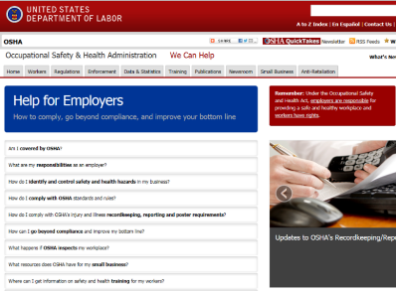
Employer Responsibilities
Provide a workplace free from serious recognized hazards (OSH Act general duty clause)
Comply with applicable OSHA standards
Provide safety training required by OSHA standards in a way that workers can understand
Post the OSHA poster, report fatalities and severe injuries, and comply with injury/illness recordkeeping requirements
www.osha.gov/as/opa/worker/employer_responsibility.html
Notes:
These are some of an employer’s key responsibilities under the Occupational Safety and Health Act. A more detailed list is available on the webpage shown at the bottom of the slide.

Slide 48
Recordkeeping and Reporting
OSHA Poster
Recordkeeping Requirements
Reporting Fatalities and Severe Injuries
Electronic Submission of Injury/Illness Data

Slide 49

OSHA Poster – It’s the Law!
It’s Free
It’s Required
Post in a conspicuous location
State Plans may have their own versions
www.osha.gov/Publications/poster.html
Notes:
The OSHA Job Safety and Health: It's the Law poster, available for free from OSHA, informs workers of their rights under the Occupational Safety and Health Act. All covered employers are required to display the poster in their workplace. Employers do not need to replace previous versions of the poster. Employers must display the poster in a prominent place where workers can see it.

Slide 50

Recordkeeping
Many employers with more than 10 employees are required to keep a record of serious work-related injuries and illnesses.
Certain low-risk industries are exempted
Minor injuries requiring first aid only do not need to be recorded.
Notes:
[Note to presenters: For more detailed slides on OSHA’s recordkeeping requirements, see https://www.osha.gov/recordkeeping/RKpresentations.html.]

Slide 51

Reporting Fatalities and Severe Injuries
All employers are required to notify OSHA when an employee is killed on the job or suffers a work-related hospitalization, amputation, or loss of an eye.
A fatality must be reported within 8 hours.
An in-patient hospitalization, amputation, or eye loss must be reported within 24 hours.
www.osha.gov/report.html

Slide 52
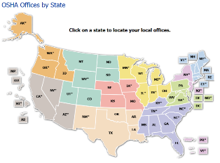
How to Report Fatalities and Severe Injuries
During business hours,
call the nearest OSHA office
Or call the OSHA 24-hour
hotline 1-800-321-6742 (OSHA)
Or report online at osha.gov/report

Slide 53
Help for Small Businesses:
OSHA’s On-Site Consultation Program
  On-Site Consultation is OSHA's preeminent compliance assistance program for small employers. In all 50 States and most Territories.
Services
  Hazard identification and correction
  Assistance in Safety and Health Program development
Benefits
  No-cost and confidential
  Exemption from OSHA's programmed inspections
  Training and technical assistance available
www.osha.gov/dcsp/smallbusiness/consult.html
Notes:
[Note to presenters: For a PPT on OSHA’s small business resources, see the O drive at DCSP/CAS Resources/Presentations/Small Businesses/.]
The On-Site Consultation Program has been serving small businesses since 1975. The program has had a big impact on businesses and their employees all over the country.
OSHA’s On-Site Consultation Program offers no-cost and confidential advice to small and medium-sized businesses in all states across the country, with priority given to high-hazard worksites. On-Site Consultation services are separate from enforcement and do not result in penalties or citations. Consultants from state agencies or universities work with employers to identify workplace hazards, provide advice on compliance with OSHA standards, and assist in establishing safety and health programs.

Slide 54
Other Outreach Initiatives and Resources
Temporary Workers
Young Workers
Workplace Violence
Spanish-Language Resources

Slide 55
Protecting Temporary Workers:
A joint responsibility
Both host employers and staffing agencies have roles in complying with workplace health and safety requirements and they share responsibility for ensuring worker safety and health.
Legally, both the host employer and the staffing agency are employers of the temporary worker.
Shared control over worker = Shared responsibility for worker

Slide 56
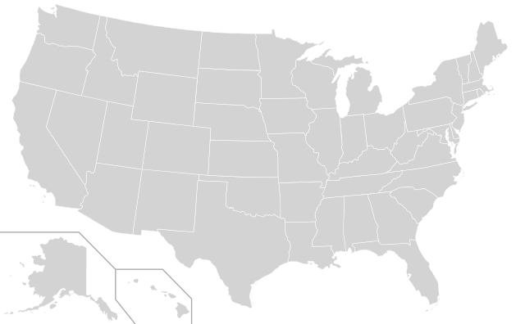
Temporary Workers
3 million people are employed by staffing companies every week.
17 million temporary and contract employees are hired by U.S. staffing firms over the course of a year.
Source: American Staffing Association

Slide 57
Why Are Temp Workers At High Risk of Injury?
New workers are at increased risk of injury.
Host employers don’t have the same commitment to temporary employees as to permanent ones.
Employer who bears the risk of the injury (temp agency) does not control safety and health investment.

Slide 58
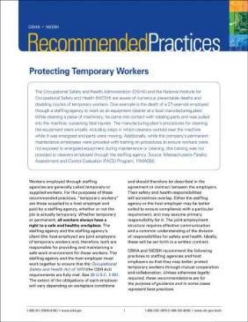
Temporary Workers:
Outreach & Education
Temporary Worker Recommended Practices
Series of Temporary Worker Initiative Bulletins
Alliance with American Staffing Association
www.osha.gov/temp_workers

Slide 59

Prevent Workplace Violence
OSHA RECOMMENDS:
Policy Statement
Hazard/Threat/Security assessment
Workplace controls and prevention strategies
Training and education
Incident reporting and investigation
Periodic review with employee input
www.osha.gov/SLTC/workplaceviolence
Notes:
In most workplaces, the risk of workplace violence can be prevented or minimized if employers take appropriate precautions.
One of the best protections employers can offer their workers is to establish a zero-tolerance policy toward workplace violence. This policy should cover all workers, patients, clients, visitors, contractors, and anyone else who may come in contact with company personnel.
By assessing their worksites, employers can identify methods for reducing the likelihood of incidents occurring.
OSHA believes that a well-written and implemented workplace violence prevention program, combined with engineering controls, administrative controls and training can reduce the incidence of workplace violence in both the private sector and federal workplaces.
This can be a separate workplace violence prevention program or can be incorporated into an injury and illness prevention program, employee handbook, or manual of standard operating procedures.
It is critical to ensure that all workers know the policy and understand that all claims of workplace violence will be investigated and remedied promptly.
In addition, OSHA encourages employers to develop additional methods as necessary to protect employees in high risk industries.
OSHA has guidelines for preventing workplace violence in healthcare and social services settings.

Slide 60
Worker Rights
All workers have the right to:
  Raise a safety or health concern with their employer or OSHA, request personal protective equipment, or report a work-related injury or illness, including COVID-19.
  Receive information and training on job hazards in their workplace.

Slide 61
Work Refusals under the OSH Act
Under the OSH Act, employees have the right to refuse to perform an assigned task if they:
  Have a reasonable apprehension of serious injury or death arising from a hazardous condition at the workplace; and
  Refuse in good faith to expose themselves to the hazardous condition; and
  Have no reasonable alternative; and
  Have insufficient time, due to the urgency of the situation, to eliminate the danger through resort to regular statutory enforcement channels (i.e., contacting OSHA or an OSHA State Plan); and
  Where possible, sought from their employer, and were unable to obtain, a correction of the dangerous condition.

Slide 62

Whistleblower Protection
Most offices have a whistleblower Investigator
Covers retribution for
safety and health activities, such as filing complaints
Cover 22 statutes
Notes:
OSHA inspectors cannot be in every workplace. That is why protecting whistleblowers is vitally important.
These individuals risk their jobs to raise concerns about hazards that may cause harm to themselves, their coworkers, or to people they have never met.
Employees who stand up for what is right, and who act with the public good in mind, should be protected from retaliation.
The OSH Act makes it illegal for employers to retaliate in any way against workers who raise safety and health concerns.
OSHA’s whistleblower protection program is tasked with enforcing this and 21 other distinct statutes.
OSHA takes its whistleblower protection responsibility seriously.
The Agency is constantly looking for ways to make its whistleblower program even stronger and more effective. This includes developing outreach materials and revising its website to make it easier to find information about the program.
OSHA has also made it easier for people to file complaints, by offering an option to file online.
Most OSHA offices have a whistleblower investigator. OSHA routinely evaluates the effectiveness of the training provided to its whistleblower investigators.
We owe it to all employees to provide effective recourse against retaliation.
Test Question:
22. OSHA must issue a citation within ___ of the occurrence of the violation: (TLO 5)
Three months
Six months
Twelve months
Five years
23. Citations are signed by the OSHA Area Director but they are not effective until they become a final order of: (TLO 5)
The Assistant Secretary for OSHA
The Occupational Safety and Health Review Commission
The Solicitor of Labor
The Secretary of Labor

Slide 63
Whistleblower Protections
What Rights Do Employees Have?
Under the OSH Act, employees have the right to:
Act of Congress
Report unsafe conditions and injuries to management or to OSHA
Assist an OSHA investigation
Request PPE
OSH ACT
of 1970

Slide 64
Whistleblower Protections under the OSH Act
Employers cannot retaliate (fire, lay off, demote, etc.) against employees for engaging in activity protected under the OSH Act.
Protected activity includes:
  Requesting personal protective equipment
  Wearing personal protective equipment
  Reporting a work-related injury or illness, including COVID-19, to an employer or OSHA
  Reporting an unsafe condition to an employer or OSHA
  Requesting guidance on workplace safety from an employer, OSHA, or other government entity
Notes:
More information on whistleblower protections can be found at www.whistleblowers.gov.

Slide 65
Whistleblower Protections
What is “Retaliation”?
Employers cannot retaliate against workers who exercise their rights. Retaliation includes:
Reducing pay or hours
Firing, laying off, or suspending a worker
Reassigning, disciplining, or demoting
Harassing, threatening, or intimidating
Blacklisting from hiring
RETALIATION

Slide 66

Whisteblowers.gov
Notes:
For more information, visit whistleblowers.gov.

Slide 67
For continual updates
Visit OSHA’s website to sign up to receive OSHA information:
  QuickTakes biweekly newsletter
  Tip of the Day
  www.osha.gov/contactus
Follow OSHA on social media
  Twitter: @OSHA_DOL
  Facebook: Follow the Department of Labor page
www.osha.gov/coronavirus

Slide 68

OSHA QuickTakes
Free OSHA e-newsletter delivered twice monthly to more than 200,000 subscribers
Latest news about OSHA initiatives and products
to help employers and workers find and prevent workplace hazards
Sign up at www.osha.gov
www.osha.gov/quicktakes

Slide 69


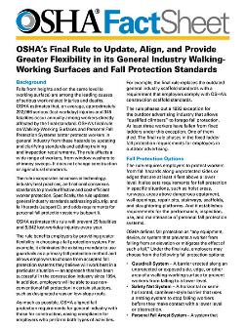



OSHA Publications
www.osha.gov/publications
Notes:
Visit OSHA’s publication page for fact sheets, QuickCards, booklets, and other publications on a variety of topics. You can sort the publications by topic, type, and language.
Some publications can be ordered online from the publications webpage.

Slide 70


Spanish-Language Resources
OSHA Webpage
OSHA Poster
Publications
Videos
800 Number
Dictionaries
Notes:
OSHA Webpage has a Spanish version – click on the “Spanish” link at the top right. The page is auto-translated.
The OSHA poster and many other publications are available in Spanish.
OSHA provides Spanish-speaking operators on its 800 number, a Spanish-language option for its e-correspondence system (to contact OSHA online with general safety and health questions), and Spanish-language information on how to file a complaint.
Dictionaries: English-to-Spanish and Spanish-to-English dictionaries of OSHA terms, general industry terms, and construction terms.

Slide 71
Referrals
Name of employer
Location / Address of employer
Alleged hazard
Location of hazard
Name of employee / exposed persons
  Identifying information kept confidential

Slide 72
Contact Us
Toll-free hotline: 1-800-321-OSHA (6742)
Submit email questions through OSHA’s website at www.osha.gov
Contact your local OSHA Area Office
  Wichita Area Office: 316-269-6644 / 316-796-8830 (Ask for duty officer)
  Mcdonnell.david@dol.gov
Notes:
Go to www.osha.gov and click on “Contact Us” link in “About OSHA” tab.

Slide 73

OSHA
www.osha.gov
800-321-OSHA (6742)

