Slide 1
Say What?
Serving Customers with Limited English Proficiency (LEP)

Slide 2
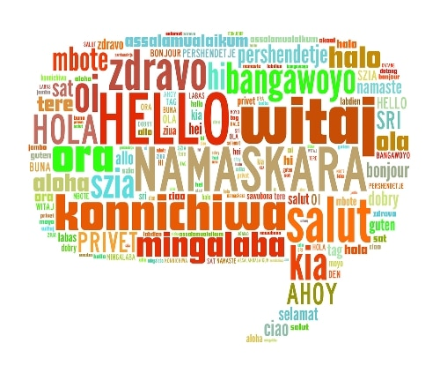
Important Definitions
Limited English proficient (LEP): An individual whose primary language for communication is NOT English and who has limited ability to read, speak, write, and/or understand English
Translator: Individual who has received training in the skills of translation and can competently render a message written from one language into one or more languages
Interpreter: Individual who has received training in the skills of interpretation and can competently render a message spoken from one language into one or more languages
Qualified interpreter: Individual who demonstrates expertise and ability to communicate information effectively, accurately, and impartially in both English and the other language
Meaningful access: refers to the provision of reasonable language assistance services at no cost that enable an LEP individual to have substantially equal participation in and access to the benefits of our services

Slide 3
LEP in the Laws
The 1964 Civil Rights Act “No person in the United States shall, on the ground of race, color or national origin, be excluded from participation in, be denied the benefits of, or be subjected to discrimination under any program or activity receiving federal financial assistance.” —42 U.S.C. § 2000d.
Executive Order 13166 “Improving Access to Services for Persons with Limited English Proficiency” was issued and directed federal agencies to:
• Publish guidance on how their recipients can provide access to LEP persons.
• Improve the language accessibility of their own programs.
• Break down language barriers by implementing consistent standards of language assistance across federal agencies and amongst all recipients of federal financial assistance.
The Order covers all federal and federally assisted programs and activities.

Slide 4
LEP in WIOA
“Section 188 of WIOA specifically requires covered entities within the workforce system to take reasonable steps to ensure meaningful access to LEP individuals served or encountered so that they may be effectively informed about and/or able to participate in programs and activities….. [T]he workforce system should provide high quality of service and serve the needs of all customers. (TEN 28-16, Change 2)”
As a federally funded institution, the WFC is required to abide by these regulations
It’s just good customer service to make sure all individuals have equal access to our services and programs

Slide 5
Identifying LEP Individuals
At the Front Desk (or when first meeting with a customer)
Use your best judgement and don’t be afraid to ask their preferred language
Use the language identification flash cards to help determine language preference if necessary
If a bilingual employee is available, request assistance in checking them in
If the customer speaks a language other than one spoken by staff, utilize appropriate resources
Google Translate is okay to use at check in & when making an appointment
Also use Language Line if necessary

Slide 6
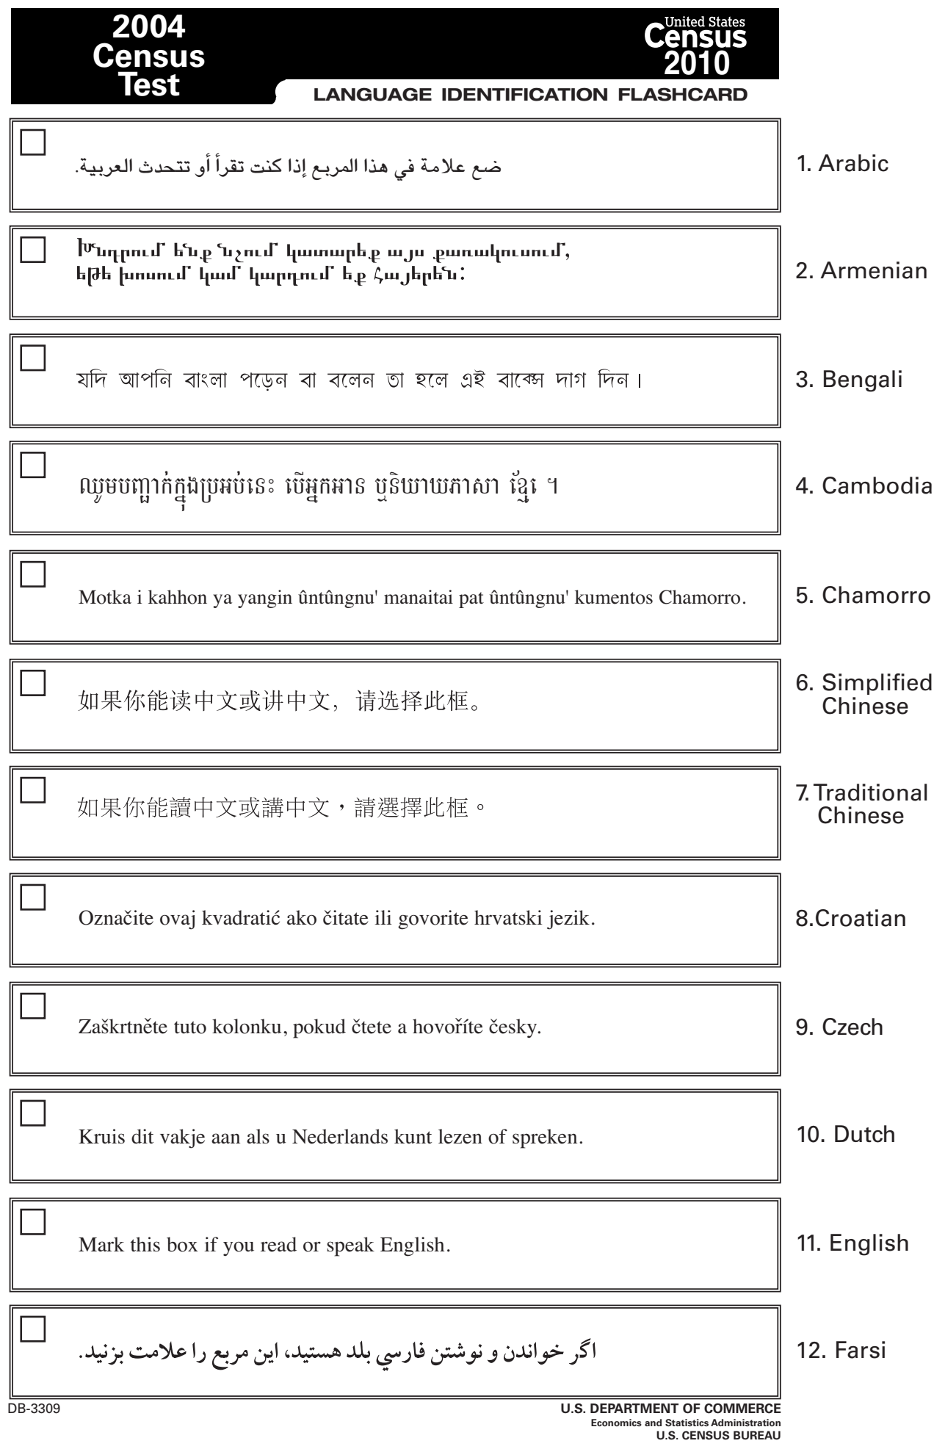
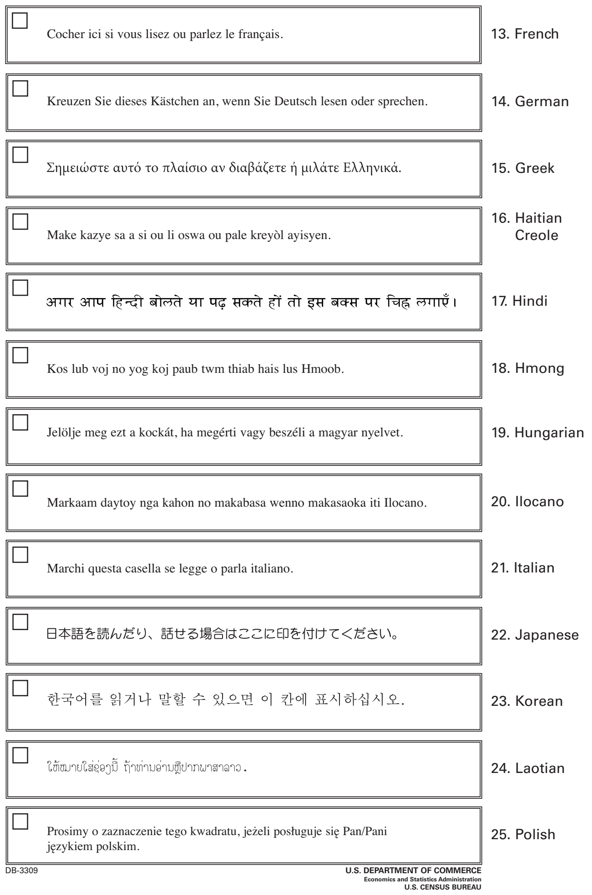
Language ID Flash Cards

Slide 7
Serving LEP Customers
Remember, proficiency in one form of communication (speaking, reading, writing) doesn’t guarantee proficiency in all forms
Many people can be conversationally proficient in a language and still struggle with specialized vocabulary
If you find the customer is struggling to communicate or comprehend, determine if they’d prefer to continue in an alternate language
Use the language question in KANSASWORKS as an opener
Is it hard for you to speak, read, write, or understand English and: (a) English is not your native language or (b) You live in a family or community where English is not the main language?
If they agree, use the appropriate resources to assist
Language Line is our current tool to assist LEP customers

Slide 8
Serving LEP Customers (cont’d)
Speak slower with LEP customers (not louder)
Be careful not to speak to someone like they’re dumb. It’s easy to come off as condescending when speaking slowly.
Enunciate and use voice intonation
Make sure to fully pronounce each word (this should also help in speaking slower)
Be aware that intoning upwards at the end of a sentence makes it sound like a question; use this when appropriate
Hand gestures & body language
The physical part of speaking is just as important make sure that your gestures aren’t distracting from your speech
Be aware of what messages you’re conveying with your body language & facial expressions
If/When working with an interpreter, watch out for acronyms

Slide 9
Language Line
Accessible 24/7 for phone interpretation, so use it!
Can do 3-way calling as well (not on outgoing Google Voice; use *67 to block number on personal phone)
Over 200 languages can be interpreted
Simply call Language Line, enter the client ID and then go for it
See the Language Line Quick Reference Guide on the Intranet for phone number & ID
Document information about using Language Line in any case notes that are entered
Include that the customer was LEP and requested interpretation services
Include the language of choice
Include the interpreter’s (Language Line calls them linguists) name and id number

Slide 10
Additional Considerations
Children and family members of customers should not be relied upon to provide interpretation services
Likely don’t have experience with the specialized vocabulary we use
Cannot be an impartial interpreter/translator
Google Translate is amazing, but limited. It should not be used when providing services
Use Translate when checking in customers or making appointments only
Machine based translations are able only to decode language rather than interpreting meaning
May not have specialized vocabulary
Translations of our customer forms will be available in the future

Slide 11
LEP Resources
Interagency Video Communicating Effectively with Limited English Proficient Individuals: https://www.youtube.com/watch?v=vv3IBZkUgwg&feature=youtu.be (only slightly ridiculous)
LEP.gov, A Federal Interagency Website: https://www.lep.gov/
Kansas Department of Labor: https://www.dol.ks.gov/espanol
Social Security: https://www.ssa.gov/site/languages/en/
Unemployment: Doesn’t have a dedicated Spanish page; however several of their forms are translated.
WFC LEP Policy (update coming w/in next month) can be found in the “About” section on workforce-ks.com

Slide 12
Questions, Concerns, Comments?
Thanks for coming!

