Slide 1
Incident Reports and You
When, Why, and How to complete Customer Incident Reports

Slide 2
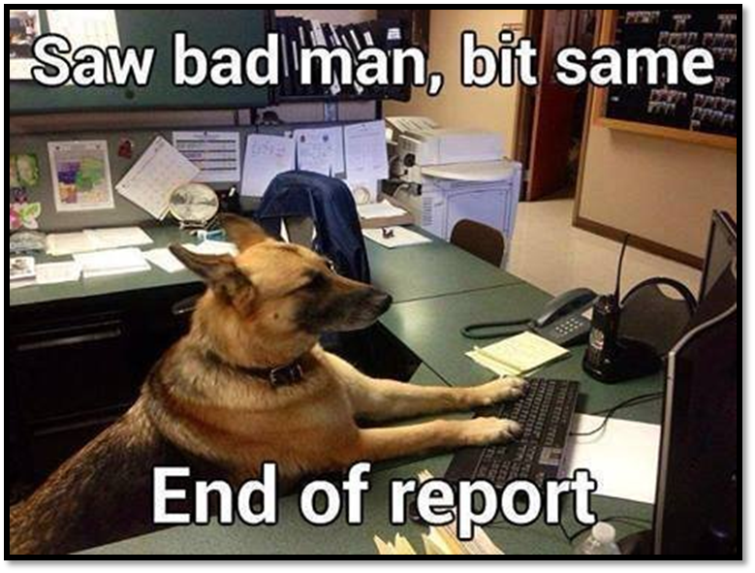
Has There Been an Incident?
Typically customer incidents warranting a report fall into one of three categories:
Behavior Based (no immediate danger)
Injury or Accident (Medical assistance)
Threatening Behavior (Police assistance)
No matter the type of incident, staff should always seek out a supervisor/director to assist with the situation
If no supervisor is available, notify immediate supervisor ASAP
Incident reports should be completed within 24 hours

Slide 3
Behavior Based Incidents
You go to the front to call your next customer and they are asleep in their chair. You wake them and take them to your desk. During the meeting, they are uncooperative and borderline hostile. You ask if they’d prefer another staff member assist them; they agree. You go to talk to a co-worker about taking your customer. When you return, they are asleep in their chair again.
You and your co-worker wake them, ensure they’re medically okay, and ask them if they’d like to proceed. They say yes, and your co-worker takes over and has a similar experience, though the customer does see the appointment through to the end with your co-worker.

Slide 4
Report it? Yeah, that seems right.
This customer is clearly not ready for a job, for whatever reason
A change in staff should be documented
They may have a problem and this could be the start of a line of inappropriate behaviors
In order to head problems off down the road, there must be documentation to support a ban or restrictions
Take it to a supervisor if they weren’t involved already, and they’ll determine if a formal incident report is required

Slide 5
Behavior Based Incidents
A customer, who has been in to see several WPs prior to your meeting, mentions loudly that the reason she lost her previous job was because “those Asians took it.” She continues to make culturally insensitive remarks while discussing her work history. You successfully redirect her and continue with the session.

Slide 6
Report it? I totally handled it.
Even though you were successful in redirecting the customer and were ultimately able to help them, their behavior was unprofessional and potentially offensive
As this was a returning customer, it’s likely other WPs have experienced similar behaviors with this customer
Talk the incident over with your supervisor. Discuss if this was an isolated incident or if they have been repeating this behavior
The supervisor will decide if an incident report is warranted. If they decide it’s not necessary, a Job Seeker Note objectively detailing the situation and what was done to resolve it must be entered in KANSASWORKS

Slide 7
Behavior Based Incidents
You’re assisting a new customer and while going over their work history, they spend five or so minutes talking about how much they hated their previous employer. You’re able to redirect them and carry on with the appointment. However, each time you mention work they make a comment about their previous employer.

Slide 8
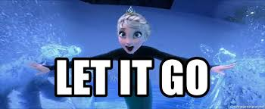
Let it slide? But they wouldn’t shut up!
It sounds like this customer was just venting
Nothing offensive, just their grievances
Didn’t get in the way of providing the assistance they required
If there’s a question, talk with your supervisor

Slide 9
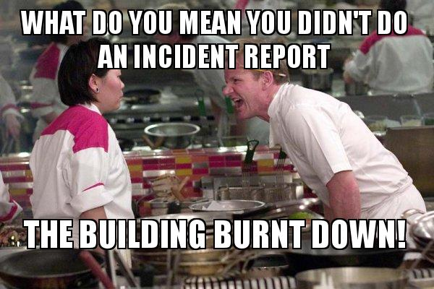
Other Incidents
If you see an emergency happening: CALL 911 FIRST, then get a supervisor
Call 911 if a person, animal, or property has been harmed or is in danger of being harmed
Call 911 if you need a police officer, firefighter, or ambulance
Check out Sedgwick County’s “About 9-1-1” page for additional information
Any time the police, EMS, or Fire Department has to be called, a report must be completed
Any time someone is injured (even if it’s minor, even if they refused medical assistance), a report must be completed
This includes minor slips and falls
Don’t forget, Security is available via phone, MiCollab, email, and in person

Slide 10
Time to Report
Incident Report forms are found on the Intranet (WFC029-0910 Incident Report)
Try to gather as much information as possible during the event; this includes any witnesses and their information
Listed witnesses should be asked to complete additional incident reports or provide a statement to be included in the report
Staff involved should be the one to complete the form, then submit it to the supervisor in attendance

Slide 11
Supervisors & Reports
Attending supervisors will add their comments, details about actions taken, and the resolution of the incident
Supervisors will submit the completed Incident Report through M-Files using the “Incident Report” class of documents found under “Customer Incident”
If a customer has to complete an activity before receiving additional services or has other restrictions, Supervisors will enter a Job Seeker Note stating “See incident report dated XXXX” in KANSASWORKS

Slide 12
Key Takeaways
If a customer is behaving in an offensive or inappropriate manner, discuss it with your supervisor
Incident reports are key in establishing patterns of negative behavior, which is the main reason customers have restrictions placed on their accounts
Supervisors will determine if a formal report is necessary for behavior based incidents
Any time the authorities are called, a report MUST be filed
In an emergency, call 911 first
Any time anyone is injured, even if it’s minor, a report MUST be filed
Involved staff begin the incident report and then send it to the attending supervisor (email or paper is fine)
The Supervisor completes the report and submits it through M-Files

Slide 13
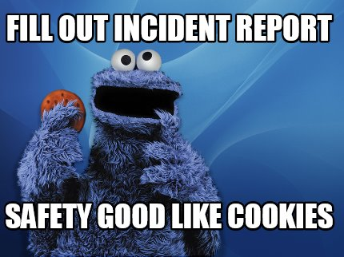
Questions, Comments, Concerns?

