Slide 1

Hype for Skype
WorkKeys scores
April 2020 – Staff How-To Skype

Slide 2
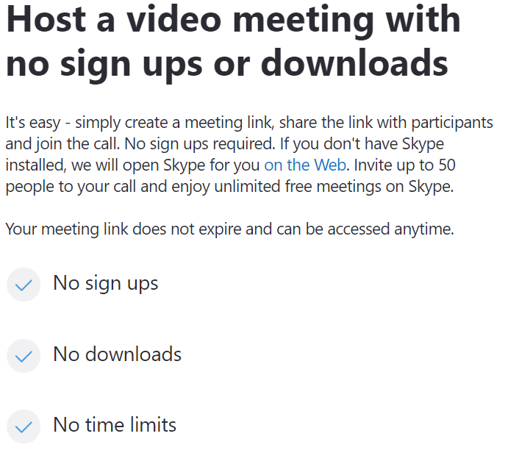
WorkKeys scores

Slide 3
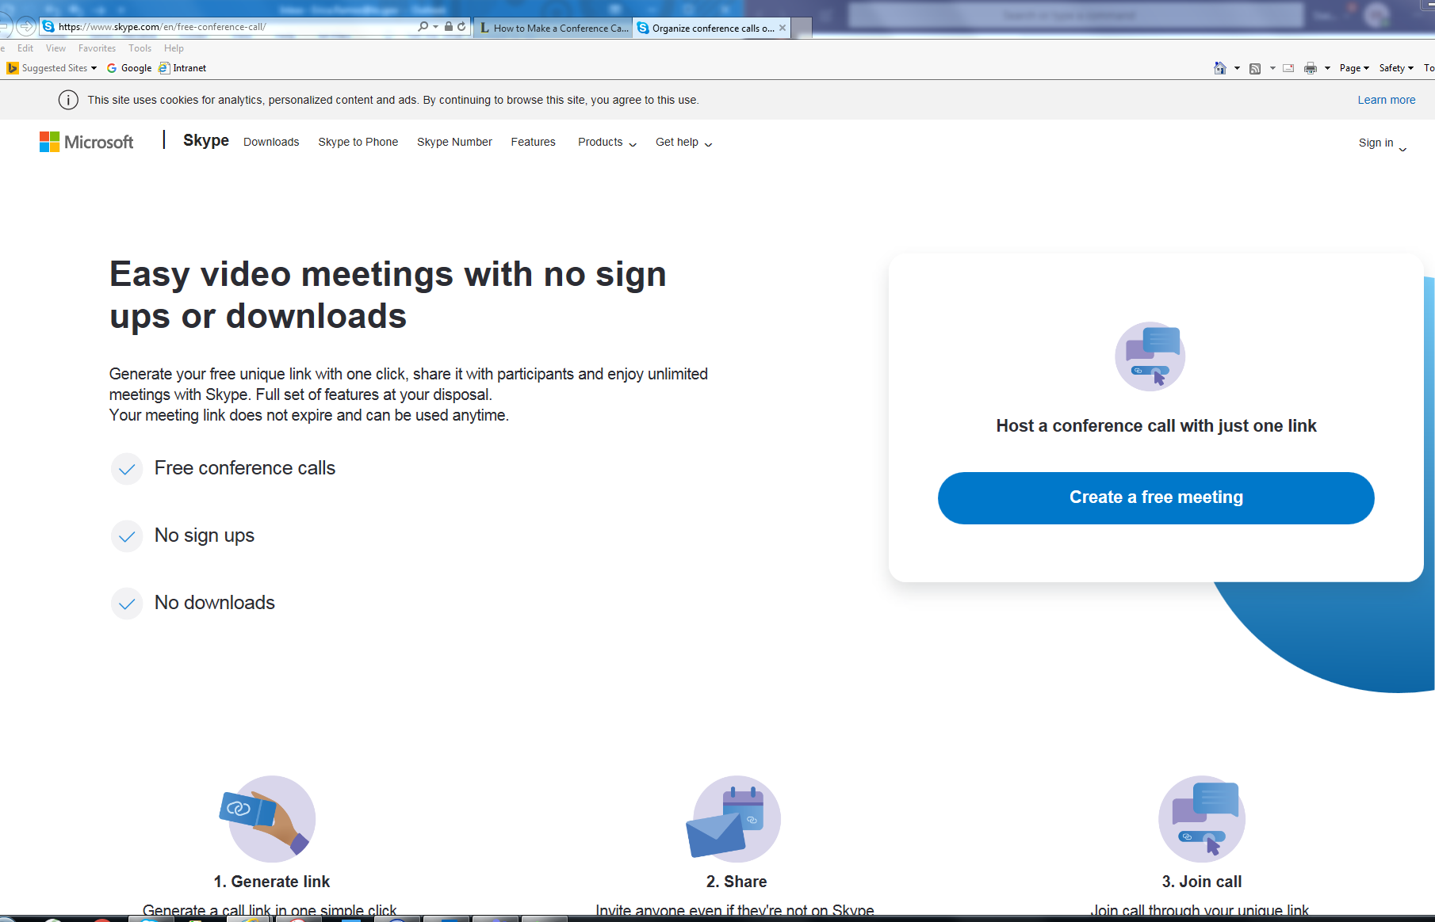
Skype – The Basics – Free!:
  Open Google Chrome
  Copy & Paste Web Page
    https://www.skype.com/en/free-conference-call/
WorkKeys scores

Slide 4
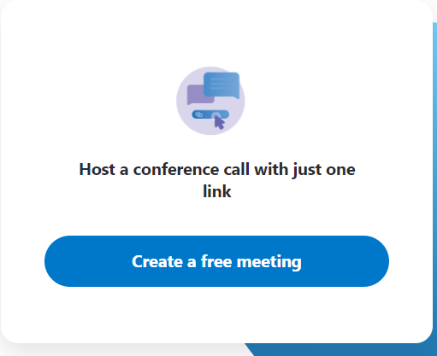
Skype – The Basics – Host a meeting:
  Click on:
  “Create a free meeting”
WorkKeys scores

Slide 5
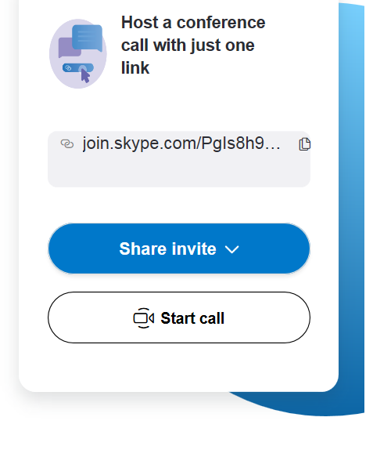
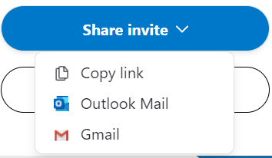
  Click on:
  “Share invite”
WorkKeys scores
When you copy and paste you can paste the link to any email account, such as Yahoo, and also add the Skype link as an appointment on your calendar.

Slide 6
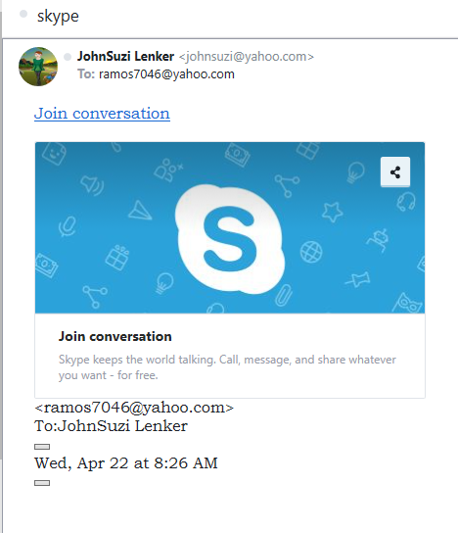
  If you “Copy link” & send via any email, like Yahoo,[NOT Outlook or Gmail] the Customer will see this
WorkKeys scores

Slide 7
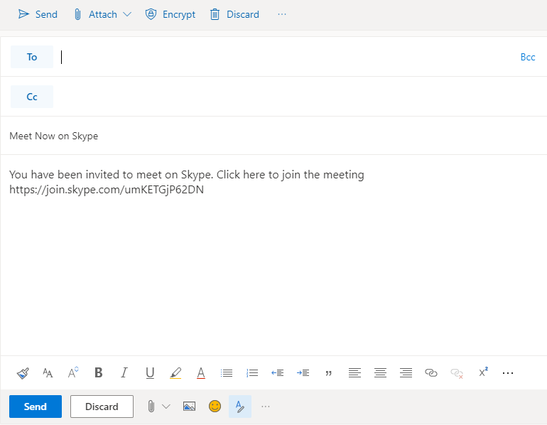
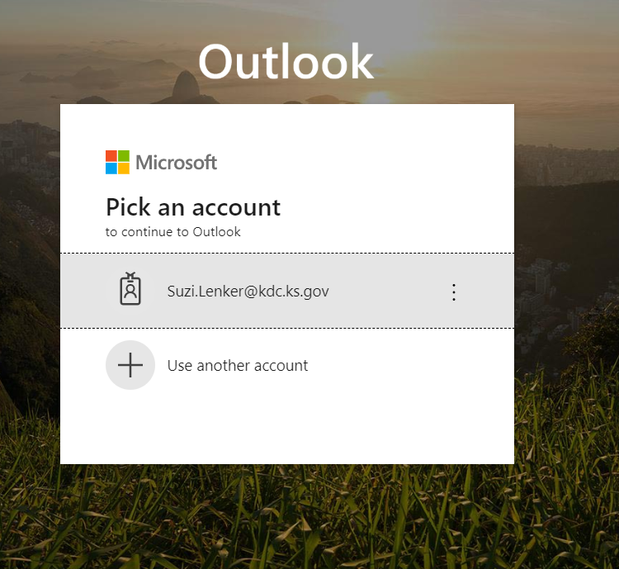
Then this new email box will open with Meeting Link included:
If you click on “Outlook Mail” –
It will open YOUR Outlook email login window on the Web Portal…
WorkKeys scores

Slide 8
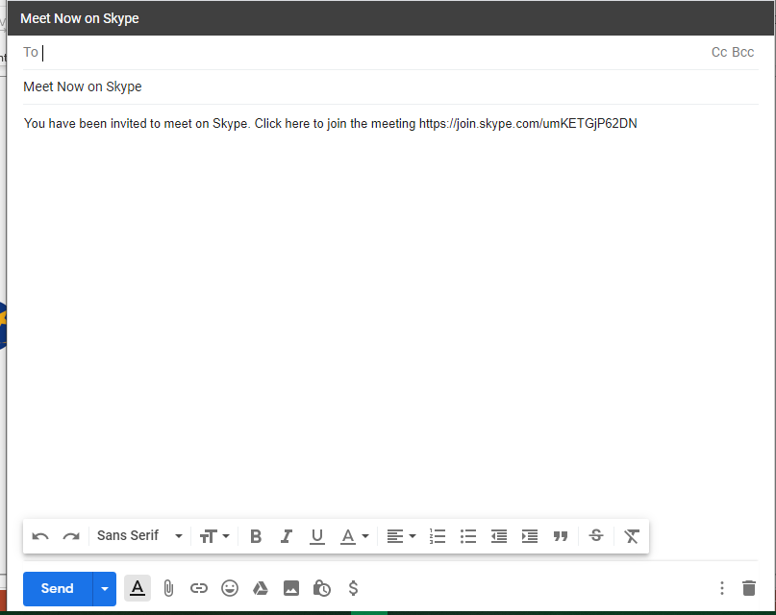
If you click on “Gmail”
It will open this screen…
This also includes the meeting link-
WorkKeys scores

Slide 9
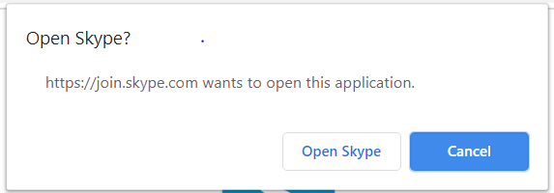
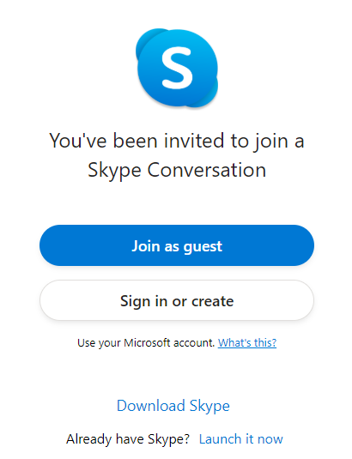
-
  Click on:
  “Start call”
  Click on:
  “Join as Guest”
WorkKeys scores

Slide 10
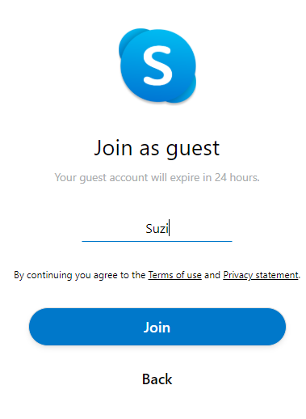
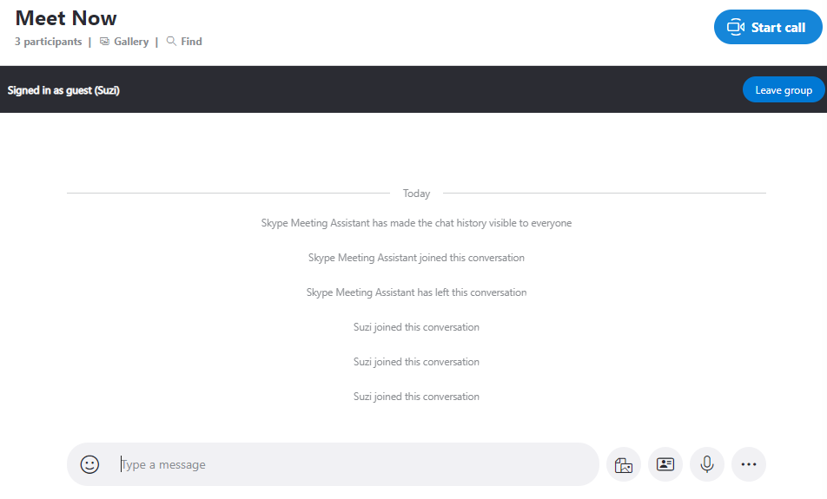
  Type your name
  Click on “Join” then
  Click on “Start call”
WorkKeys scores

Slide 11
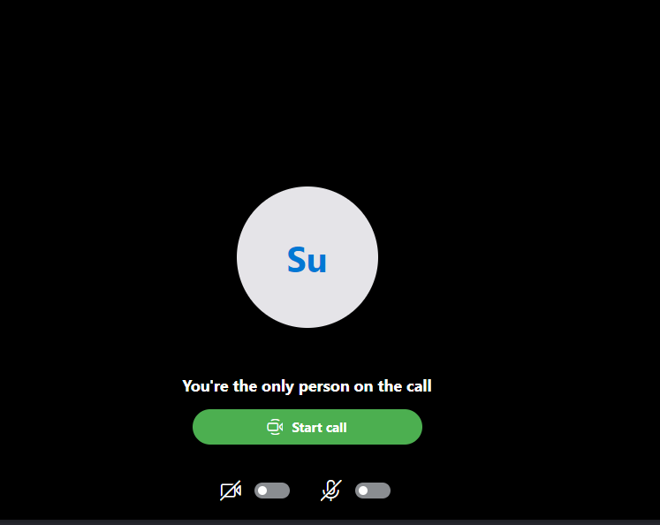
  Turn on Video
  Turn on Mic
  Click on
    “Start call”
WorkKeys scores

Slide 12
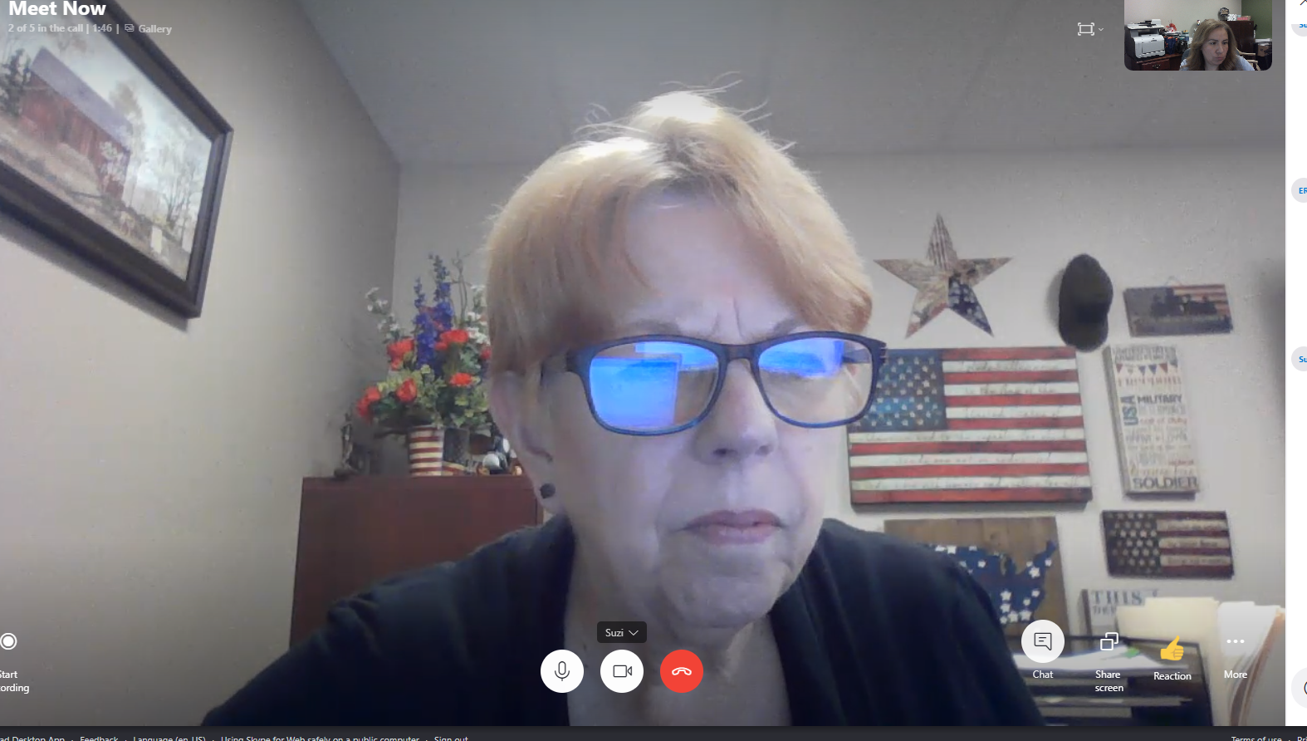
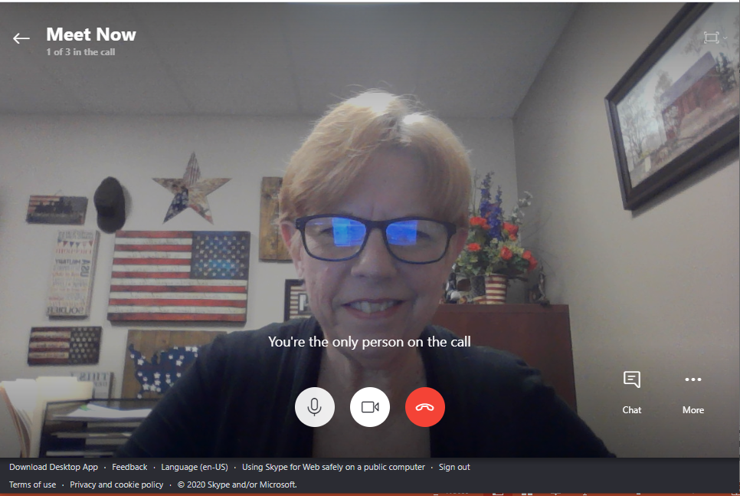
  When the Customer joins you will see them in the upper right hand corner…
  You should see YOU!
WorkKeys scores
  If the customer does not have a camera, you will see the circle with the first two letters of the name that they used to sign in.

Slide 13
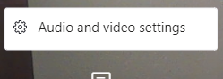
Skype – Features on your screen:
Click More for your audio & video settings
This little box will open
WorkKeys scores

Slide 14
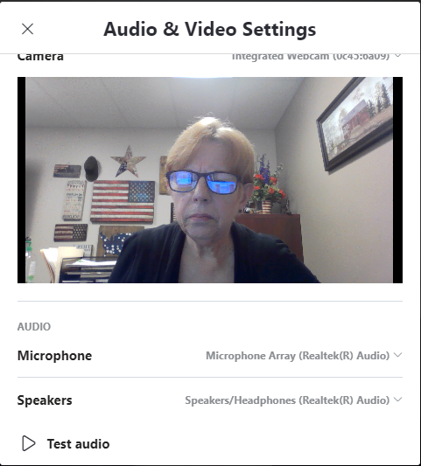
Skype – Features on your screen:
At the top it lists the camera you are using
Then it lists the Microphone and Speakers you are using
Next, it has a “Test audio” feature where you should hear a sound & confirm that you hear a sound
WorkKeys scores

Slide 15

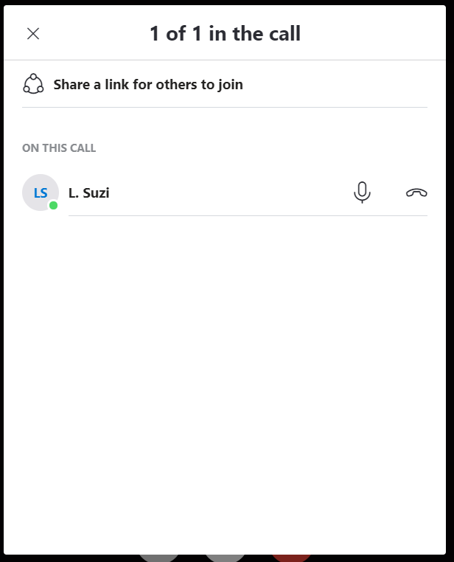
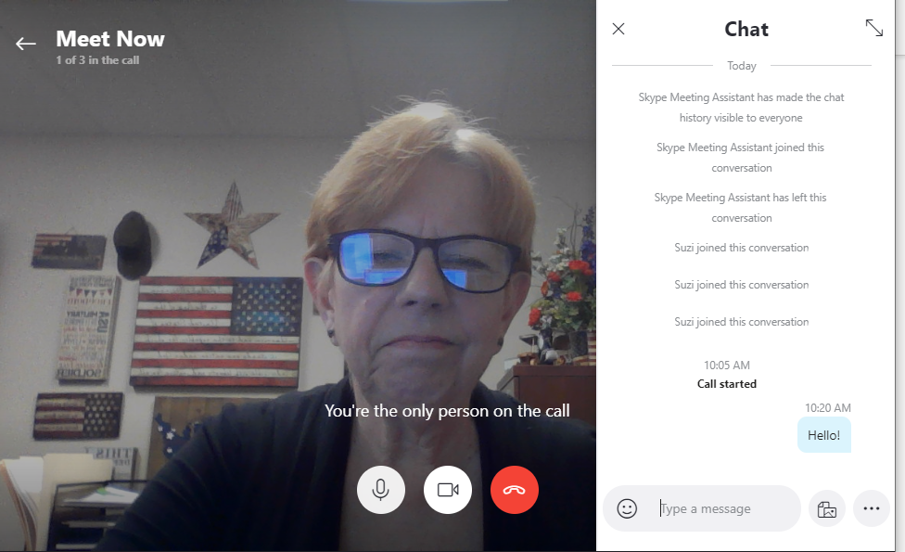
Skype – Features on your screen:
Click “Meet Now” feature
WorkKeys scores

Slide 16

Skype – Features on your screen:
Click “Chat” feature
WorkKeys scores

Slide 17
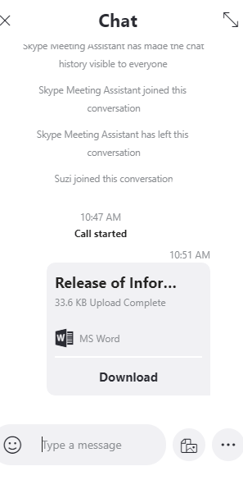
Skype – Features on your screen:
Click “Add Files” feature
WorkKeys scores

Slide 18
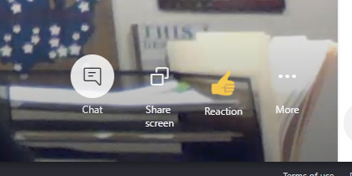
Skype – Features on your screen:
Click “Share screen” feature-
The other person will be able to see live video of what's on your screen, including your desktop and any programs you may have open.
WorkKeys scores

Slide 19
Skype – Features on your screen:
Click “Reaction” feature
To “react” with emoticons…
WorkKeys scores

Slide 20

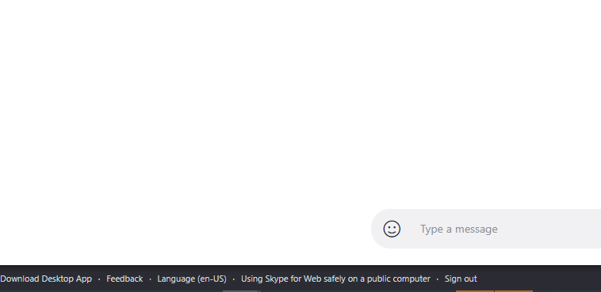
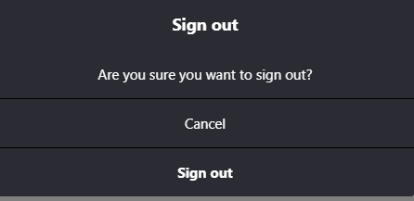
Skype – The End- Two Options:
OR
If you sign out you will see this message:
WorkKeys scores

Slide 21

WorkKeys scores
Questions?

