Slide 1
Hanging out with Google
Another option for connecting with Customers

Slide 2
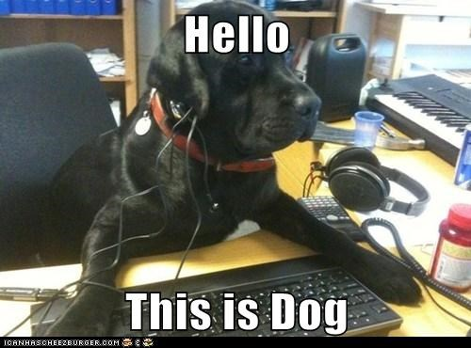
Capabilities
One-on-one or group chats (up to 100 people)
Voice & video calls (group calls up to 10 people)
Must register a phone number to make calls
Works across devices synced with Google account
Works with Android and Apple phones
MUST have a Google account to access
To host & to participate

Slide 3
Chat Set Up
1. Once logged into a Google account, access Hangouts chat feature through Gmail or by going to hangouts.google.com
2. Choose the “Message” option to invite someone to chat
3. The recipient can go to hangouts.google.com after logging into their Google account, click the three bars at the top left to access more options, find invites and accept the invitation to chat.

Slide 4
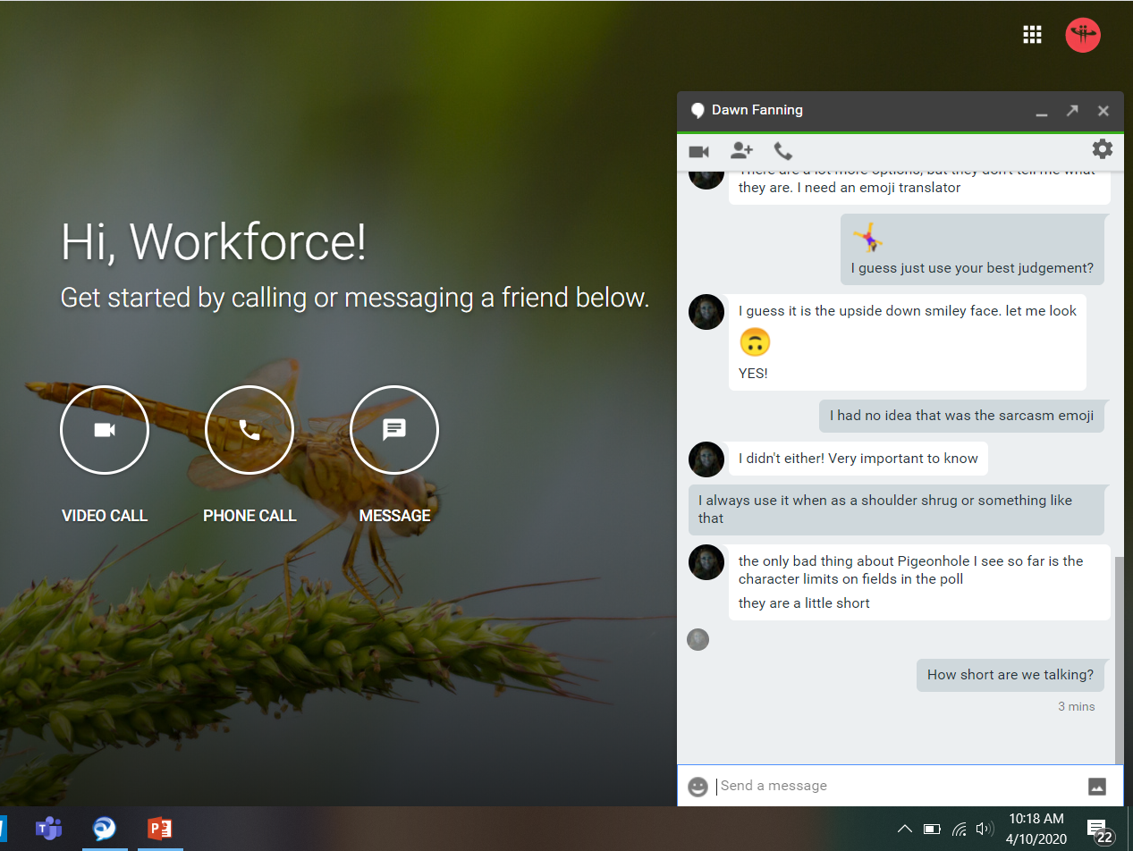
Chatting
Chats appear at the lower right of your screen when you have either the hangouts window or Gmail open
They can be “popped out” by clicking the arrow at the top right of the chat
This opens the chat in a new window and allows you to move it around
They can also be “popped in” by clicking the arrow again
You can chat with up to 100 people at a time
A full range of emoji are available, you can also insert and send images

Slide 5
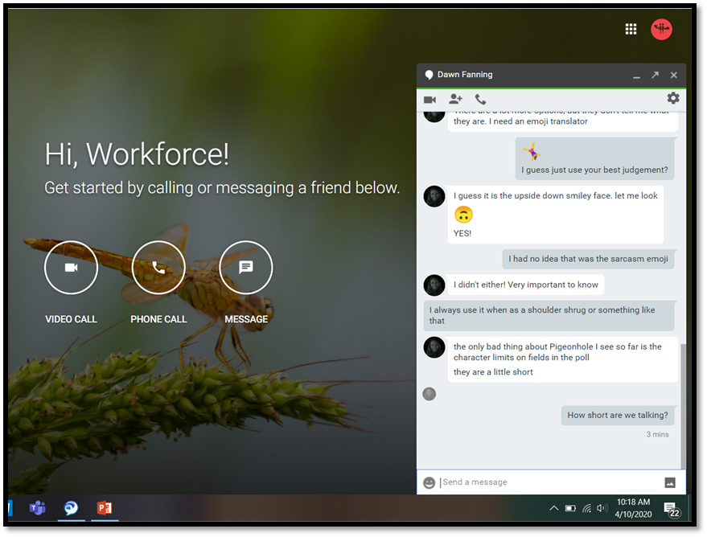
Video Calls
You can switch to a video call in the chat box by clicking on the camera icon
You can also start a video call by choosing the “Video Call” option from the Hangouts site
Then invite people through email or by copying the link and sharing

Slide 6
Video Call Features
Turn video on/off by clicking on the camera button
Mute audio with the microphone button
End the call by clicking the red phone button
Message the group by clicking on the page icon on the left
General video and audio settings available by clicking the cog wheel
The three vertical dots drop down additional options, including share screen

Slide 7
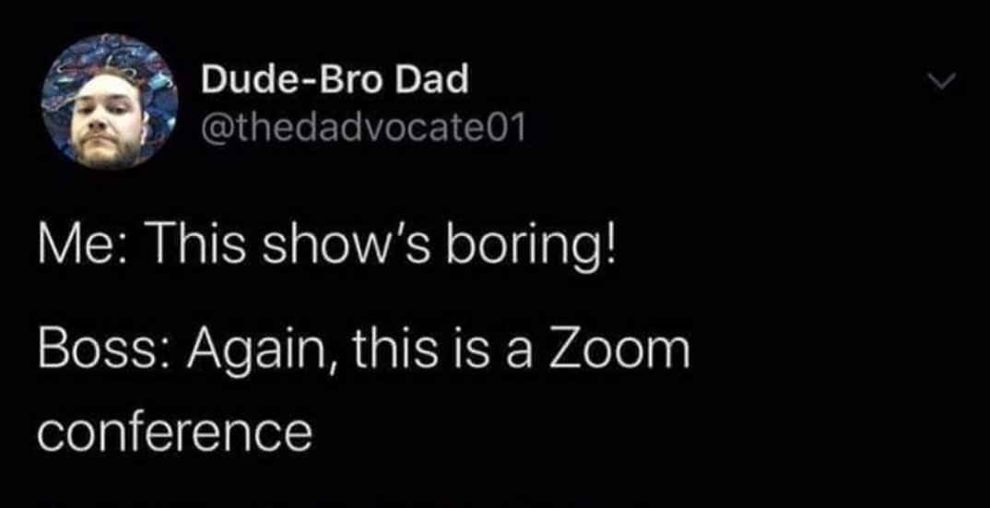
Additional Considerations
You’ll need to set up a professional Google account to access any of the products
Something like janetworkforce@gmail.com would be appropriate
Chats are not secure. Do not share Personally Identifiable Information over Google chats
On Zoom, ensure you’re using the require password for added security for PII
Accessing the video call product changes depending on the type of account you log in with
G-Suite accounts automatically use Google Meet for video calls which looks a little different

Slide 8
Homework Time!
Talk with your supervisor and set up a Zoom and Google Hangouts meeting where you’re the host
You can schedule with me too if you want
It’s anticipated that even once we get back into the Center, we’ll offer remote assistance to customers. It’s important that we’re all familiar with these as options

