Slide 1
Getting to Know the Customer Service Grid
Helping to ensure excellent customer service every time

Slide 2
“Attendance” Question
In the chat box, please share your favorite thing about Autumn.

Slide 3
Background
Adopted to help all staff understand the basic expectations for customer interactions
Find the CSG on the Intranet
Adapted from the book Performance-Based Management: What Every Manager Should Do to Get Results by Judith Hale
Consists of 10 elements with examples of unacceptable, acceptable, and exceptional behaviors
Used to help direct staff behaviors toward employer & job-seeker customers
May also be used for formal or informal self or staff evaluations

Slide 4
Customer Service Grid (page 1)
Notes:
Important to remember that these are just EXAMPLES of behaviors, it’s not meant to be a comprehensive list. Consider working on one or two behaviors at a time. I know I struggled with really listening to customers sometimes, especially if it was before lunch; I’d get hangry and impatient with the stories I assumed I heard before. Obviously, we’re all human and hanger happens, but the goal is to not let the customer see that or let it interfere with the services provided.

Slide 5
Elements
Customer Satisfaction
Suggest services, programs, and products the customer can use to meet their needs; flexibility in approach
Maintains a Courteous Workplace
Ensures that professionalism rules the day, address conflicts directly but respectfully
Prompt, Friendly Service
Acknowledge the customers who come in, put them at ease, respect their time
Closes Customer Interactions
Make employers & job-seekers feel they are valued parts of the Workforce Center
Polite Understanding
Take the time to understand the customer’s situation and address it

Slide 6
Elements (continued)
Get it Right or Make it Right
Focus on accurate, reliable, quality service to employers and job-seekers
Open Professionalism in Delivering Services
Know your job and focus on working and job-related activities while at work
Customer Focus & Follow Through
Help meet customers’ needs so that they feel they are the Center’s priority
Introduce Customers to the Person who Can Help
Directly & personally introduce customers in need of help to the person who can help
Happy Workforce Center Employees
Enjoy the work and believe the services, programs, and products are important

Slide 7
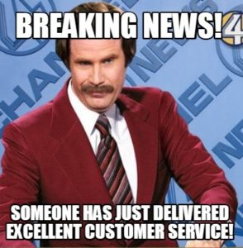
CSG in a Virtual Setting
Some elements may look different in a virtual setting, but they should not be overlooked
“Introduce Customers to the Person who can Help”
“Polite Understanding”
“Closes Customer Interactions”
Notes:
Introduce customers: This may look more like providing the name and direct email of the person who can be of assistance rather than walking them over to that person’s desk. Remember to always check with the staff member you’re handing your customer off to in order to make sure it’s okay and that they’re really the right person.
Polite Understanding: When in-person this might be paying close attention when the customer is sharing their story or trying to find a work-around if we can’t help them with exactly what they need; but virtually this may be walking them through connecting to Zoom or using other technology. It might also mean attending to more frustration in customers because of technological or other social issues. Another aspect is to focus on what we CAN do for customers, even if they ask for something we can’t actually do: “I need you to write my resume” “We don’t really write them for you, but we can make it so easy it’s like it writes itself.” and then provide templates, guidance, links to our recorded workshops, etc.
Closes Customer Interactions: This is probably even more important when delivering virtual services. It’s incredibly important to make sure customers understand what’s happening next. Are you sending them eligibility documents to sign electronically? What’s the deadline for those? Making sure they understand what they can expect from the WFC and what we need from them. This includes be clear about what’s coming next in case notes as well.

Slide 8
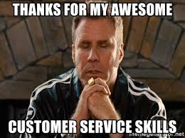
CSG for Internal Customer Service
CSG can still be used as a guide for those of us who don’t see customers and indeed for any staff interactions
“Maintains a Courteous Workplace”
“Prompt, Friendly, Service”
“Polite Understanding”
Notes:
Maintains a courteous workplace: “Takes the extra step to be sure customers feel comfortable, even in uncomfortable situations”—for me this looks like cracking some jokes, trying to have some casual conversation before trainings, or reassuring people when they ask so-called stupid questions, that they’re not stupid questions and I’m always happy to help as much as I can.
“Follows up with customer to be sure the help was appropriate”—Again, for me this looks like sending out feedback surveys, asking if my explanation makes sense, etc.
Prompt, Friendly Service: A lot of the behaviors listed in this section are about greeting the customer within a specific time frame, calling them by name, etc. But for “inside” customer service this might be answering emails or Jabbers quickly, even if it’s just to say “I’m going to look that up, hang on” or “ I’m working on another project right now, can I get back to you in X days?”
Polite Understanding: This one is sometimes tough for me because I frequently assume people know what I know or think the way I think; and that’s just not always true. So this section again deals with listening and patience with customers, so even if you ask a question that I feel like I’ve answered or you ask a question that just been asked of me (usually through email) I’m not gonna go off on anyone and be like “I don’t understand why you people can’t get it together.” or anything like that.
How can you apply the CSG to you internal customer service?

Slide 9
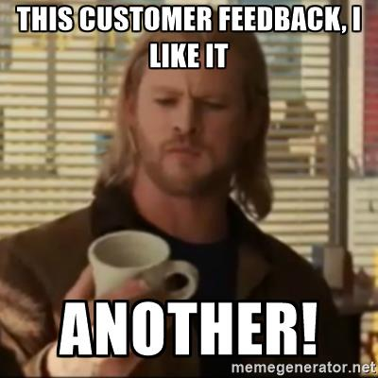
Additional Considerations
Kansas Department of Commerce Secret Shopper program is still in effect
Usually 1-2 times a year
We are still encouraging customers to fill out the customer service surveys through WaitWhile

Slide 10
Any question, comments, or concerns?

