Slide 1
Follow-up Services
Paving the way for success in employment

Slide 2
Purpose of Follow-up Services
After customers have participated in a training program, Follow-up services are offered. These services are offered to:
Identify and attempt to resolve any problems that might jeopardize employment
Provide services to ensure career progression and/or job retention
For youth who entered post secondary education/training
Assist with the adjustment to postsecondary education
Provide continued career planning & employment
Aspects of follow-up services can differ across programs.

Slide 3
Follow-Up for Adult & DW
Follow-up services must be made available to all enrolled participants for a minimum of 12 months after the first day of unsubsidized employment
Exited participants may also receive follow-up services
Follow-up services may include:
Career planning and counseling
Assistance with work-related problems
Contact with the participant’s employer, if necessary
Supportive service referrals (no WFC funded supportive services can be provided during follow up)
Other referrals that could benefit the customer
Services have to be offered, but the customer can refuse. In this case, the refusal must be documented in a case note

Slide 4
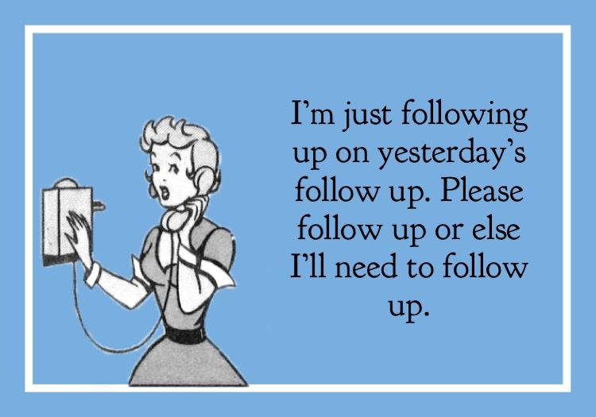
Adult & DW Follow-up
Successful follow-up services have three parts:
Contact
Interaction
Provision of acceptable services
Example: an email exchange to assist with navigating a dispute with a co-worker would be considered follow-up. Merely sending a letter to check up on the customer does not meet the three part requirement
During follow-up, contact must be made with customers at least once every 90 days; however, CMs should work with customers to set up a contact schedule that meets their needs
The contact schedule and all contacts, attempts, and services must be documented in KANSASWORKS

Slide 5
Follow-Up for Youth
Follow-up services are a REQUIRED program element and must be provided for at least 12 months after the end of the customer’s participation
Follow-up services have to align with the customer’s Objective Assessment & Individual Service Strategy, so the type and intensity of services will differ for each customer. Some services may include:
Regular contact with a customer’s employer, including assistance addressing work-related problems
Supportive Services funded through the WFC
Financial literacy education
Labor market information (LMI) & career counseling
Follow-up services must be provided unless the customer declines, they cannot be located after 90 days, or they meet one of the other reasons for exit. Everything must be documented in case notes
Notes:
Other reasons for exit: incarceration or institutionalization, medical reasons, death, called to active military duty, or exits the foster system and move out of the local area.

Slide 6
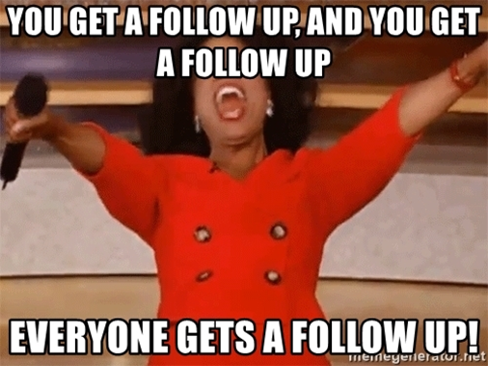
Youth Follow-up
Youth follow-up services must meet the same three-part requirements as those laid out for Adult & DW programs:
Customers should be contacted at least once every 90 days, but WPs should consult with the customer and create a contact schedule that meets their needs
The contact schedule, attempted and successful contacts, and services should all be documented in KW

Slide 7
Follow-Up Services in KW
Because follow-up services take place after the customer has completed participation in a program, the customer should be exited as usual.
Indicate that the customer will be receiving follow-up services on the exit form

Slide 8
Follow-Up Services in KW Cont’d
Open a “Follow-up Services” service in the corresponding program enrollment & enter a program note including the contact schedule and plan for services
The estimated end date should be set to the next planned contact date (or at most 90 days from the open date)
After contact and/or provision of services, the estimated end date of the service should be bumped out
When the customer has completed follow-up activities (or fallen out of contact, etc.) the CM should close the service

Slide 9
Returning Customers
“Returning” here means the customer comes back to the WFC in need of services that do no fall into the regular category of follow-up services.
If it’s been over 90 days since their last program service (not including follow-up), and their exit has not processed, the WP will need to email Wendy R and have her process the exit so an enrollment can be re-opened.
If the exit/closure of services has been approved, then the WP would just open the enrollment as usual and complete eligibility as necessary
If it’s been less than 90 days since their last program service, WP should contact Wendy R to let her know the exit should be denied. The WP should then provide services as usual
Notes:
For instance: if a customer talks to someone in the career center and they find the customer had gained unsubsidized employment, lost that employment and returned to apply for additional training, then the WP would need to check the follow up status (look for open Follow-Up Services, check in Client notes to see if the exit has been submitted and/or approved).

Slide 10
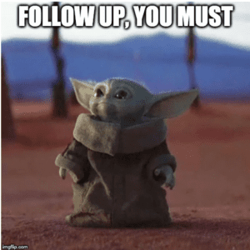
Questions, Concerns, Comments?
Any experience providing Follow-up Services?
Pop quiz time!

