Slide 1
Documenting Contact with Customers
A various note review

Slide 2
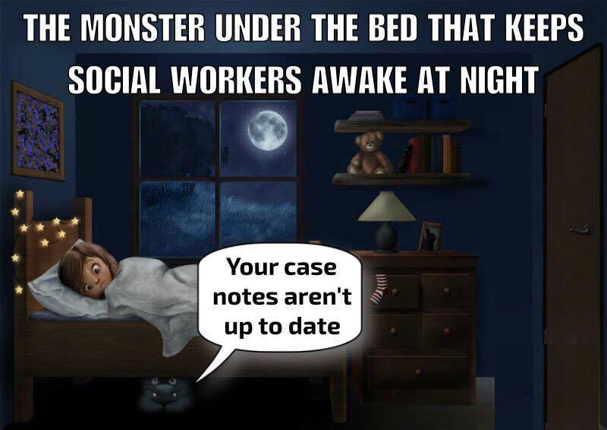
Types of Customer Contact
Let’s play: WHERE DOES IT GET DOCUMENTED! (You can answer in the chat)
If you call a job seeker but leave a voice mail?
Client Notes
If you have a conversation about services with a job seeker on the phone?
Program Notes
If you provide a service to a job seeker?
Program Notes
If you attempt contact with an employer?
Employer Notes
If you have a conversation with an employer and provide a business service?
Business Contact Tracking
Finish this sentence: “If it is not in case notes,
it didn’t happen”.

Slide 3
Note Locations & When to Use Them
Client notes
Used for “one-way” communication: leaving messages, sending emails that aren’t immediately returned, program approvals/denials, etc.
Also used for communication with someone other than the customer about the customer (such as a school or employer)
Program notes
Used for “two-way” communication: any time you have a conversation with a customer, the documentation goes in the program notes for the highest open enrollment
Employer Notes
Used when attempting contact with a business and if services are provided to employers without any two-way contact
Employer Contact Tracking
Used when two-way communication occurs AND a Business Service is provided

Slide 4
Basics of Any Note
Notes are crucial to any customer (job seeker or employer) file
Provide a chronological record of the customer’s involvement in the Center
Detail progress within programs
Explain the need for services
Provide a rationale for all of the actions and documents in the file
Help other staff members determine what has been done and what still needs to be completed to assist the customer
Notes must include the 5Ws and 2Hs
Who
What
When
Where
Why
How
How much

Slide 5
Note Must-Haves
For WPs & CMs
Customer’s employment history
6 month’s past & current
Any Unemployment Insurance information
If they’ve filed
If they’re currently receiving
If they’ve exhausted
If in a training program, any information about progress
Official grade reports
Any credentials attained
For BSRs
Contact Tracking Notes
A purpose & result of the interaction and subsequent services provided
Plan of action moving forward
Employer Notes
Details of the attempted contact and any services provided

Slide 6
Most Importantly
Notes must include details about the services provided to the customer
This is where the 5Ws and 2Hs come in
Use facts only; no opinions
Be detailed, but also as clear and succinct as possible
Once the note is signed and entered, it becomes a legal document; things like spelling and accuracy matter!
Notes should also include an explanation of any documentation included in the file
Anything submitted for approval or uploaded to KW should be explained in the note
Emails can be pasted into the note field, but they should still be easily readable
Do NOT include the signature or confidentiality statement that appears at the end of emails

Slide 7
BSR Contacts
Employer contacts are entered whenever an interaction with a business occurs, and at least one business service is provided to that business customer (refer to the Business Team Service Definitions on the intranet for further details on these)
These are typically entered by Business Services Representatives (BSRs), but should also be entered by staff from programs in the Workforce Center as appropriate, such as:
for participating WIOA Youth Program work experience employers
for SCSEP work experience employers
Employer Notes are used for attempted contacts and can include a service or services not listed on the Business Team Services Definitions guide, whereas Employer Contact Tracking has to include both a business service and a two-way interaction with the business
Job Seeker Case notes should be entered whenever a BSR has provided business services to a job seeker customer, such as employer assessments
The corresponding services should also be entered into KW

Slide 8
Note Templates
There are lots of them, make sure you’re using the right one
Check the Intranet!
If you use templates, they MUST BE INDIVIDUALIZED; be sure to include the correct name and details for the current client, and remove any placeholders or irrelevant items
Use the templates for email communications
Templates cover the minimum required information; you can and should add to them if you feel like it’s necessary for clarification

Slide 9
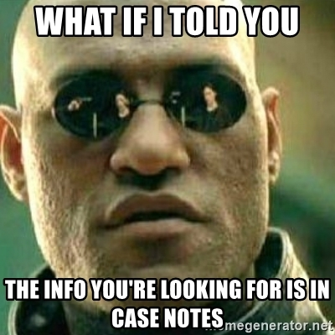
Common Note Issues
Failing to address paperwork included in the file
Noting services that were provided but services were not opened in KW
Conversely, failing to note services provided that were opened in KW
Including the wrong customer name or details in a note
Contradictory information (such as note indicates unemployed, while demographics and/or paperwork in file indicate employed, etc.)

Slide 10
Now Let’s Recap: Does it Require a Case Note and Where Does it Go?
(You can answer in the chat)
You call a job seeker and leave a message with their spouse
Yes, Client Notes
You speak with a school about a client funded by us and confirm their progress
Yes, Client Notes
You speak with a client to request they return books and tools since they dropped out of their training program
Yes, Program Notes
You leave a message for an employer regarding a Youth Program work experience placement
Yes, Employer Notes
You speak with an employer about a SCSEP participant and help them set up a job fair
Yes, Employer Contact Tracking

Slide 11
Questions?
Sergei looks possibly prepared to answer them…
Alas, Tucker does not seem prepared to do much of anything.

