Slide 1
Concurrent Basic Education & Occupational Training

Slide 2
What is Concurrent Education?
Concurrent basic education & occupational training happens when a customer needs occupational skills training (OST), but lacks a high school diploma or GED
This is a requirement for most OST funded through Adult/DW
CNA and CDL are a couple of programs of study that do not require a secondary credential
Customers work on their GED or High School Diploma at the same time they attend Occupational Skills Training

Slide 3
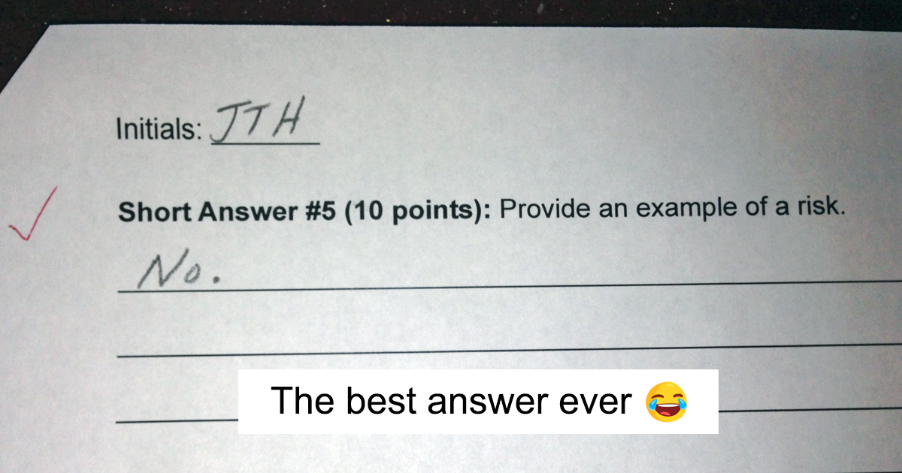
Options for Customers who need Concurrent Ed Services
Customers who are interested in training but lack a HS Diploma or GED are TABE or CASAS tested to determine their levels and how long it would take for them to get the GED
Depending on the training and how close they are to finishing a GED/Diploma, the WFC may be able to assist with concurrent education services
Customers must attain the GED/Diploma before the end of training
Any funds spent on GED/Diploma are included in the total amount allowed for training
If the customer would be unable to complete the GED/Diploma before OST, a referral to one of our ABE partner should be made.
Training will be an option once they’ve attained their secondary credential
The maximum length for training is 2 years; however, the program is more focused on short-term certificates

Slide 4
Process for Customers in need of Concurrent Ed Services
Double check to see if the customer meets the requirements for referral to the Youth program
The WIOA Youth program can fund GED/Diploma completion if the customer meets eligibility requirements
Adult and DW CANNOT fund GED training alone; if the customer is only interested in GED training, a referral to an ABE partner is the most appropriate step
Referral process is the same for Adult or DW, jut note on the form that the customer lacks a GED/Diploma and needs concurrent education
Customers may enroll in separate, but concurrent, GED and OST classes through approved training providers
Customers in need of concurrent education may also participate in the Accelerating Opportunity: Kansas Program

Slide 5
Accelerating Opportunity: Kansas (AO-K)
The AO-K program helps students prepare for the GED and earn college credits at the same time
There are a variety of short-term certificate programs and associate degree options
AO-K Career Pathways vary by school but many include several of our own pathways
WSU Tech
Manufacturing (Composites, Machining, Welding, and others)
Healthcare (CNA, HHA, Medication Aide)
Information Technology (CompTIA)
Hutchinson Community College
CNA, HHA, Medication Aide
HVAC
Welding

Slide 6
Questions, comments, concerns?
Time to check your understanding!

