Slide 1
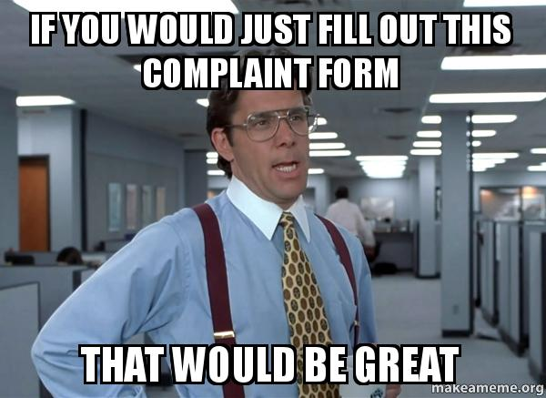
COMPLAINT AND APPARENT VIOLATIONS TRAINING

Slide 2
Background
Changing the way we take and process customer complaints and apparent violations
All complaints or apparent violations will be documented using new complaint form
1 process for all types of complaints and apparent violations: program, employer, discrimination, migrant seasonal farmworker, etc.
Complaints and apparent violations will now be put into M-Files and put through a workflow

Slide 3
Definitions
Complaint
Submission of a written and signed allegation of violation of laws or regulations
This could fall into several categories
Programmatic
Claims of discrimination
Claim against an employer
Apparent Violation
Violation of employment related laws by an employer where a WP observes, has reason to believe, or is in receipt of information regarding a suspected violation

Slide 4
Definitions
Employment Related Law Violation
Employer violated the terms and conditions of a job order
Employer violated employment related law such as wages, working conditions, child labor laws, sanitation, housing standards, etc.
Programmatic
Allegation we as employees of the Workforce Center did not follow a law or regulation
Discrimination
Allegation of discrimination due to race, color, religion, sex including pregnancy, childbirth and related medical conditions, sex stereotyping, transgender status, and gender identity, national origin including limited English proficiency, age, disability, political affiliation or belief and citizenship

Slide 5
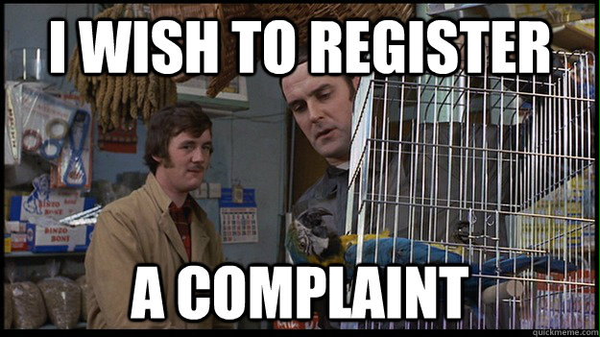
Complaint Form
Using U.S. Department of Labor Employment and Training Administration Form 8429
Form will be posted on the Intranet
Make sure to use form from the Intranet as it has been made a fillable form and has the correct expiration date on it
Only give customers page 1 of document
Page 2 is for our use only

Slide 6
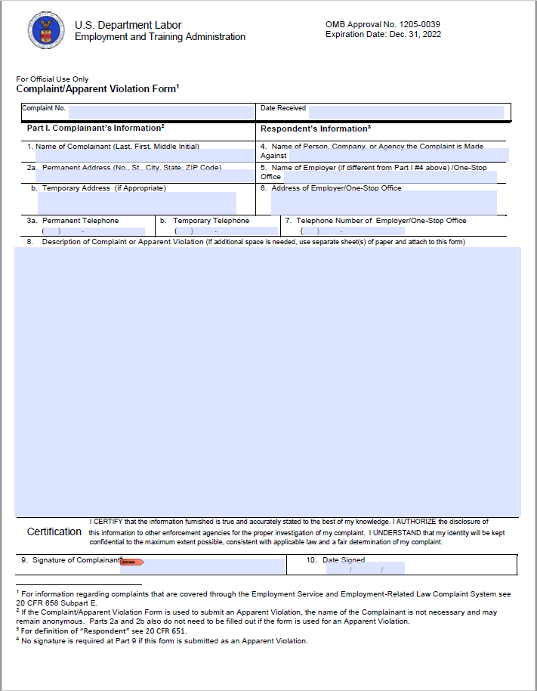

Slide 7
Complaint Form-Page 1
Complaint Number: Leave blank
Date Received: Date person came in, filed complaint and signed document or date apparent violation was observed or information was obtained
If complaint received by email or mail, date it was received by staff

Slide 8
Complaint Form – Page 1
1. Name of Complainant: Full name of person filling complaint
2a. Permanent Address: Complainant’s complete permanent address
2b. Temporary Address: Put NA if not applicable or enter Complainant’s complete temporary address
3a. Permanent Telephone: Complainant’s permanent telephone number
3b. Temporary Telephone: Put NA if not applicable or enter Complainant’s complete temporary telephone number
If form used for apparent violation: 1, 2a, and 2b do not need to be filled out

Slide 9
Complaint Form-Page 1
4. Name of Person, Company, or Agency the Complaint is Made Against: Name of person, company, agency complaint is against or is involved in the apparent violation
This could be an employer, specific person, agency, etc.
5. Name of Employer if different from #4/One Stop Center: Name of employer if different than above or name of One Stop if filing complaint against us
6. Address of Employer/One-Stop Office
Address of employer for complaint or apparent violation or One- Stop Office if complaint is against us
7. Telephone Number of Employer/One-Stop Office: Telephone number of employer if complaint or apparent violation or One-Stop Office is complaint is against us

Slide 10
Complaint Form-Page 1
8. Description of Complaint or Apparent Violation:
If complaint, the complainant may type or hand write the complaint
May attach additional pieces of paper if necessary
Provide as much detail as possible about complaint or violation
If the complainant desires assistance in completing the form staff must offer assistance including typing or hand writing the form
If this is done, staff must type or write EXACTLY what the complainant says
Complainant must sign and date the form

Slide 11
Complaint Form-Page 1
8. Description of Complaint or Apparent Violation:
If apparent violation no signature is required by staff or person who provided information
If apparent violation staff would complete section 8 detailing the apparent violation

Slide 12
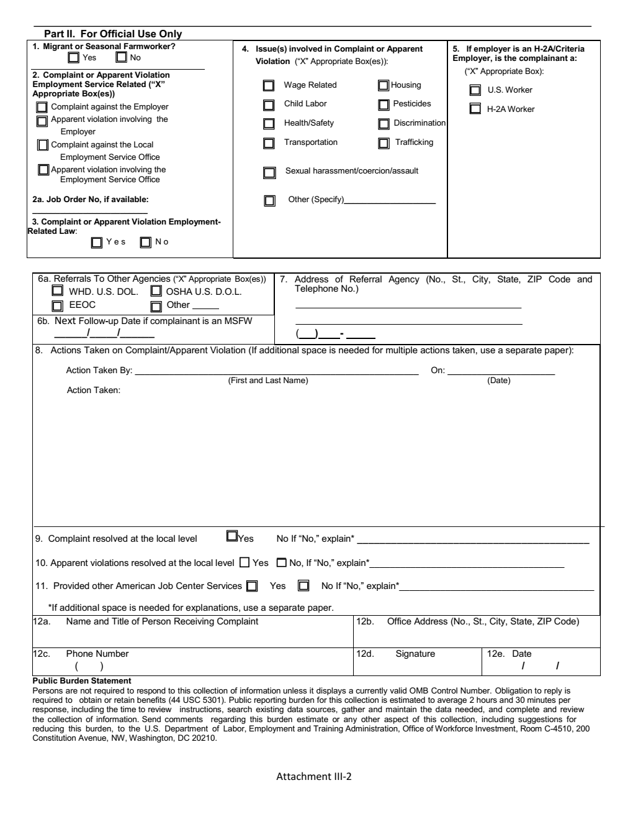

Slide 13
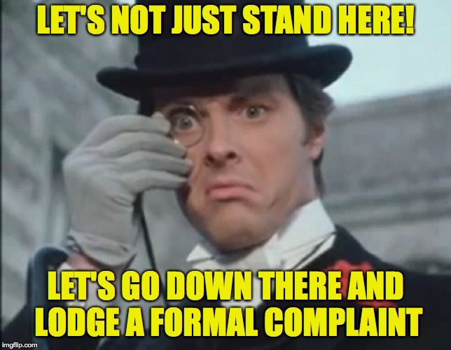
Complaint Form-Page 2
Page 2 is for staff use only
WPs will complete part of this page and leave other parts to be completed later

Slide 14
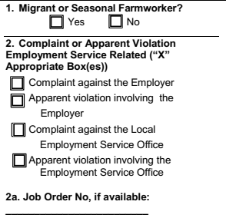
Complaint Form-Page 2
1. Migrant or Seasonal Farmworker: When customer is discussing complaint WPs should determine whether or not the customer is a Migrant or Seasonal Farmworker (MSF) based on the definition provided
The actual definition is broader than you think
This is important as complaints from MSF are handled differently from other complaints
Specific timeframes apply to complaints from MSF
2. Complaint or Apparent Violation: Check the appropriate box(es) based on the definitions
2a. Indicate the job order if one was involved

Slide 15
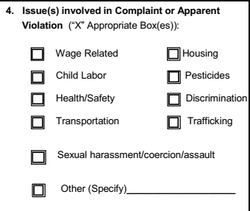
Complaint Form-Page 2
3. Complaint or Apparent Violent Employment Related Law: Check the box that apply to the complaint or apparent violation
4. Issue(s) involved in Complaint or Apparent Violation: Check the boxes next to the issues that are included in the complaint/apparent violation. You may also specify additional issues if needed. Check the boxes the best you can based on the information in the complaint or apparent violation
Notes:
Employment Related Law Violation
Employer violated the terms and conditions of a job order
Employer violated employment related law such as wages, working conditions, child labor laws, sanitation, housing standards, etc.

Slide 16
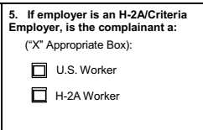
Complaint Form-Page 2
5. H-2A/Criteria Employer: If H-2A employer, indicate if the complainant is a US Worker or an H-2A Worker

Slide 17
Complaint Form-Page 2
6a. Referrals To Other Agencies:
If the complaint involves hours, wages, minimum wage, child labor, overtime, family leave, etc. you would take the complaint and also make a referral to the Wage and Hour Division of US DOL (WDH. U.S. DOL.) WHD U.S. DOL has a card you print out and give them on how to file a complaint. Check that box
If the complaint involves a workplace safety or health issue you would take the complaint and also make a referral to the Occupational Safety and Health Administration (OSHA U.S. D.O.L.). OSHA has a website where you can go over the options for filing a complaint online, in person, or by phone. Check that box
If the complaint involves discrimination take the complaint and also made a referral to the Equal Employment Opportunity Commission (EEOC). EEOC has a website where you can file a complaint online, by mail, or by phone. Check that box

Slide 18
Complaint Form-Page 2
6a. Referrals To Other Agencies:
If you make a referral to another agency such as legal services or another agency put that information on the Other line and check that box.
6b. Ignore this section
7. Address of Referral Agency: Put the full address and telephone number of the agency you referred the customer to
OSHA is the only referral agency listed under 6a that has an office in Wichita
You would use the closest office address or the main office address for the agency

Slide 19
Complaint Form-Page 2
Skip sections 8-10 (these will be completed by a Supervisor)
11. Provided other AJC Services
If you provided them additional services that day check the Yes box and give a summary of services provided
If no other services were provided outside of taking the complaint, check the No box

Slide 20
Complaint Form-Page 2
12a. Name and Title of Person Receiving Complaint: Enter you name and title
12b. Office Address: Enter the address of the office you were working in when you received the complaint
If an apparent violation, enter the address of the office you normally work at
12c. Phone No: Enter the telephone number of the office you were working in when you received the complaint
If an apparent violation, enter the telephone number of the office you normally work at
12d. Sign the document either electronically or by hand
12e. Enter the date the complaint was taken or day reporting the apparent violation either electronically or by hand

Slide 21
M-files Process
After the complaint/apparent violation form has been completed staff must load the completed form into M-Files
Use the document class of COMPLAINT OR APPARENT VIOLATION, Complaint Apparent Violation Form
Use the naming conventions below:
If complaint
Complaint, Customer Name, Date, Staff Name
If apparent violation
Apparent Violation, Employer Name, Date, Staff Name
If the complainant provided any supporting document you can load that under the document class of COMPLAINT OR APPARENT VIOLATION, Complaint Supporting Documentation
Make the complaint form a multifile document in this case

Slide 22
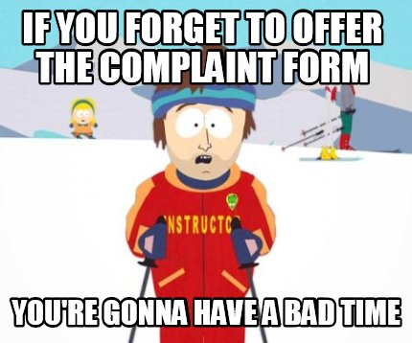
M-files Process
Complaint and Apparent Violation forms must be loaded into M-Files the day they are completed
Must be loaded and submitted before you leave the office for the day
Complaint/Apparent Violation forms are to be submitted through the Complaint or Apparent Violation workflow
Management will handle the issue from there

Slide 23
Questions?

