Slide 1
All About Referrals
Makin’ ‘em, Takin’ ‘em, and Recordin’ ‘em

Slide 2
Why Referrals?
Referrals are an important part of our work
Help create wrap around services for our customers (typically the ones that need it the most)
Help show that we’re experts in our field but not every field
Ensures customers get the best services from the most appropriate people
We’re required by WIOA to create a one-stop for customers to simplify receiving the services necessary for them to become employed

Slide 3
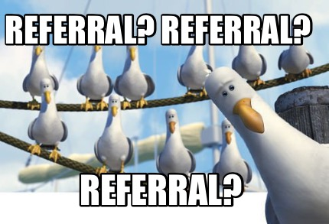
Programmatic Referrals
Programmatic referrals are those that happen within the Workforce Center
A referral to a program that is administered by the Alliance or Commerce
Dislocated Worker, KHPOP, JVSG, or TAA are examples
A referral to the Business Team
Use the Program Quick Reference Guide to help determine which program(s) might be best for the customer

Slide 4
Completing Programmatic Referrals
Depending on the program, making a programmatic referral is as easy as completing the WFC080-0910 Partner Referral Form and sending it through M-Files
Always use the “Referral to Programs/Partner Referral Form” workflow in M-Files
For those that don’t have access to M-Files, the Partner Referral Form can be completed on the Workforce Center’s website (workforce-ks.com/partnerreferralform)
For programs like Adult and SCSEP, the customer needs to complete Next Steps before the referral can be submitted
These program also have specific referral forms (WFC495-0815 Referral to Adult Individualized Career Services and WFC594-0417 Referral to SCSEP)
Always use the “Referral to Programs/Partner Referral Form” workflow in M-Files

Slide 5
More about completing Programmatic Referrals
Customers that come to the WFC with the sole purpose of being referred to a program or have been referred by a partner to a specific program, may receive that referral without an existing or open KANSASWORKS account.
Customers must know the program to which they’ll be referred
If they’re unsure, they’ll need to talk to a WP
ANY staff will complete the Partner Referral Form as usual and include a note with the customer’s KW status
If using M-Files, staff will still need to create the customer with part ID listed as 0000
Again, use the “Referral to Programs/Partner Referral” workflow in M-Files

Slide 6
Partner Referrals
Referrals to outside organizations
Includes co-located partners: American Indian Council and Flint Hills Job Corps
Use the Partner Referral List and Partner Referral Guidelines to help in making outside referrals

Slide 7
Completing Partner Referrals
Since each partner is different, consult their website or the Partner Referral Guidelines to find out if the customer meets their requirements and how best to refer clients
Note that some of the programs listed in this document are run by the WFC; this document is shared with a variety of organizations

Slide 8
Documenting Partner Referrals
Unlike Programmatic Referrals, Partner Referrals must be documented in KANSASWORKS (or the Alliance Database as appropriate)
Staff will enter a “Referral to Partner Services” service in KW
Set status to “Completed” and all the dates (est. & actual begin and end) should be the date the referral is made
Referrals should only be made to organizations on the Partner Referral List. If a referral to an organization not on the list is required, notify your supervisor and they will request the Partner be added to the list
Not all enrollments contain a “Referral to Partner Services” service. If the customer’s highest enrollment doesn’t have the service enter it under WIOA (if open) or Job Service

Slide 9
Receiving Partner Referrals
If a customer comes to you and says they’ve been referred by an organization or they actually have a referral form with them, this needs to be documented in KANSASWORKS
Staff should enter a “Partner Assessment Services” service in KW
Set status to “Completed” and all the dates (est. & actual begin and end) should be the date the referral is received; if the referral is received before an enrollment is open, then the enrollment date should be used on the “Partner Assessment Services” service.

Slide 10
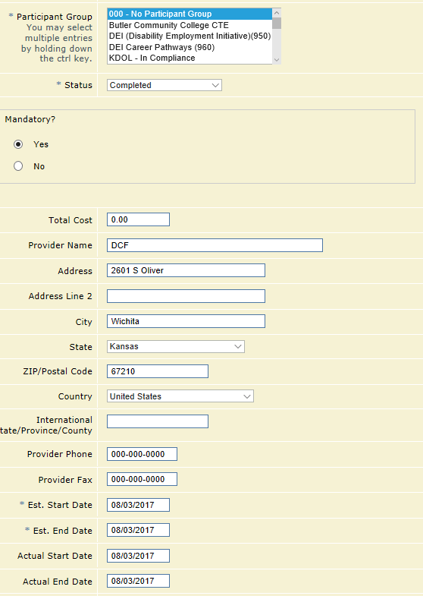
Some Screen Shots

Slide 11
Resources
If you need more clarification on how to document Partner Referrals, check out the Tracking Partner Referrals Protocol on the Intranet
If you’re looking to make some referrals, the Partner Referral List and Partner Referral Guidelines are also available on the Intranet
For more information on Programmatic and Partner Referrals, have a look at the Referral to Other Programs/Partner Referral Protocol on the Intranet

Slide 12
Questions, Comments, Concerns?
Let’s check your understanding!

