Slide 1
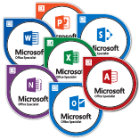
Imagine Academy
In the chat: What’s your favorite Microsoft Office product and why?

Slide 2
What is Imagine Academy?
Microsoft’s certification program that includes industry recognized credentials in:
Computer Science
Coding on a variety of technologies
IT Administration
Web security
Data Science
Data management & security
Productivity
Office applications

Slide 3
What is Imagine Academy (In the WFC)?
Self-paced preparation for official Microsoft Office Specialist certifications (2013 & 2016)
Word & Word Expert
Excel & Excel Expert
PowerPoint
Outlook
Access
SharePoint*
OneNote*
*Available on Office 2013 only
NOT workshops
Customers work on practice software, called GMetrix, which simulates the certification exams on different levels
Core Skills Review: Presents tasks one at a time and provides immediate feedback; also features a retry option
Practice Test: Presents project-based tasks as they appear in the exam, has hint options, and a timer though it’s not timed
Pretest: The closest approximation of the certification exam; no hints and a 50 minute time limit

Slide 4
What Can Customers Expect on their 1st Visit?
Customers fill out a short survey about their experience with the programs as well as provide some information about their work history.
Customers can begin at any program they like; however we usually recommend starting with Word.
They’ll practice on their chosen program for 2 or 3 hours and then take a Pretest to establish a baseline for their skills
Customers must score at least a 50% in order to immediately sign up for another session
If they don’t reach the 50% mark, we’ll provide independent study resources and ask that they build their skills for a couple of weeks before they return

Slide 5
What About Subsequent Visits?
Once customers have passed a Pretest with a 50%, they can sign up for as many sessions as they like.
Eventbrite invitations are sent out weekly on Fridays, but if customers want to attend both Monday and Friday sessions, we’ll send out additional emails.
Customers work fairly independently towards certification
Must take a Pretest at least once a month to ensure progress
Once certified in one program, customers can move on to new programs immediately if they choose

Slide 6
New Since COVID-19
We have expanded access to at home accounts; however, customers must attend their first session in-person
Afterwards, if they meet the requirements, we’ll set them up with a GMetrix home account and monitor their progress
If they don’t log in within a month, their access code will be removed
Certiport, the company that owns the exam software, has been offering “Test from Home” options for customers
Still the same process to get to take the exam, it’s just done at home with whatever version of Office the customer has
Extended through June 2021; but already scheduling out to December
Tests are scheduled through the WFC Imagine Academy team

Slide 7
Are There Benefits to Certification?
According to a 2012 MOS Productivity Study,
MOS certification increases employee confidence, loyalty, and satisfaction
82% of certified employees said becoming MOS certified gave them more confidence in their abilities as a worker
MOS certification improves employee effectiveness and initiative
88% of certified employees said MOS certification made them more effective in their work
91% of hiring managers consider certification as part of their hiring criteria
Certification exams are usually $96 each; we offer them for free!
Customers (and staff) can take part, no matter their employment status

Slide 8
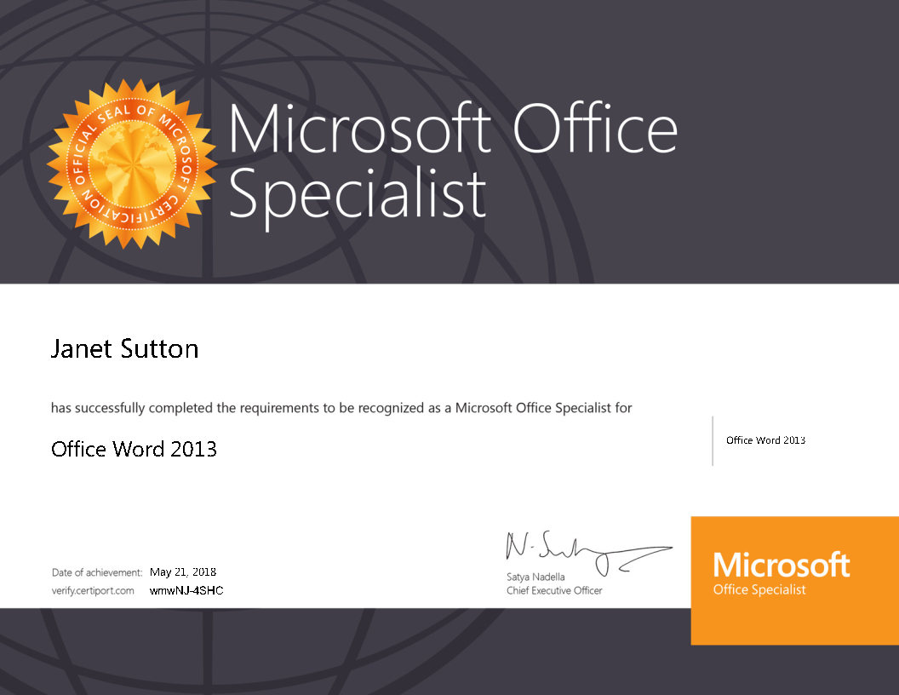

Slide 9
Are there Levels of Certification?

Slide 10
Who is a Good Candidate?
Customers interested in Imagine Academy should have at least intermediate skills in any program in which they’d like to certify
Customers should also
Be self motivated
Be able to follow written directions well
Have an email address they check regularly
Have a valid ID

Slide 11
What if My Customer isn’t QUITE Ready?
We’ve got FREE resources to help get them ready!
General Resources:
Workforce Center workshops (now online!)
Microsoft Office Independent Study Resources (on the Intranet)
Includes links to Microsoft, Wichita Public Library, GCF LearnFree, and others!
The IA webpage has all of these links quickly available!
Program Specific:
We have Word, Excel, and PowerPoint specific resources that we can email

Slide 12
How Can I Refer a Customer
Customers should have WIOA Adult open and approved before referral
Send an email to iacademy@workforce-ks.com; include
Customer’s Name
Participant ID
Email Address
Program(s) of interest (if known)
Customers will receive an Eventbrite invitation in their email. They can choose a date that works best with their schedule.
We try to send emails to the staff who refer customers to let them know when we’ve sent the email

Slide 13
What if I Want to Get Certified?
Totally doable! Just check with your supervisor, since you’re most likely going to be practicing while at work (though you can practice at home if you want)
We’ll help you create a GMetrix account so you can track your progress
Same process for staff as for customers: 85% on at least one Pretest before attempting the certification exam.
Certification exams have to be taken during regular Imagine Academy sessions

Slide 14
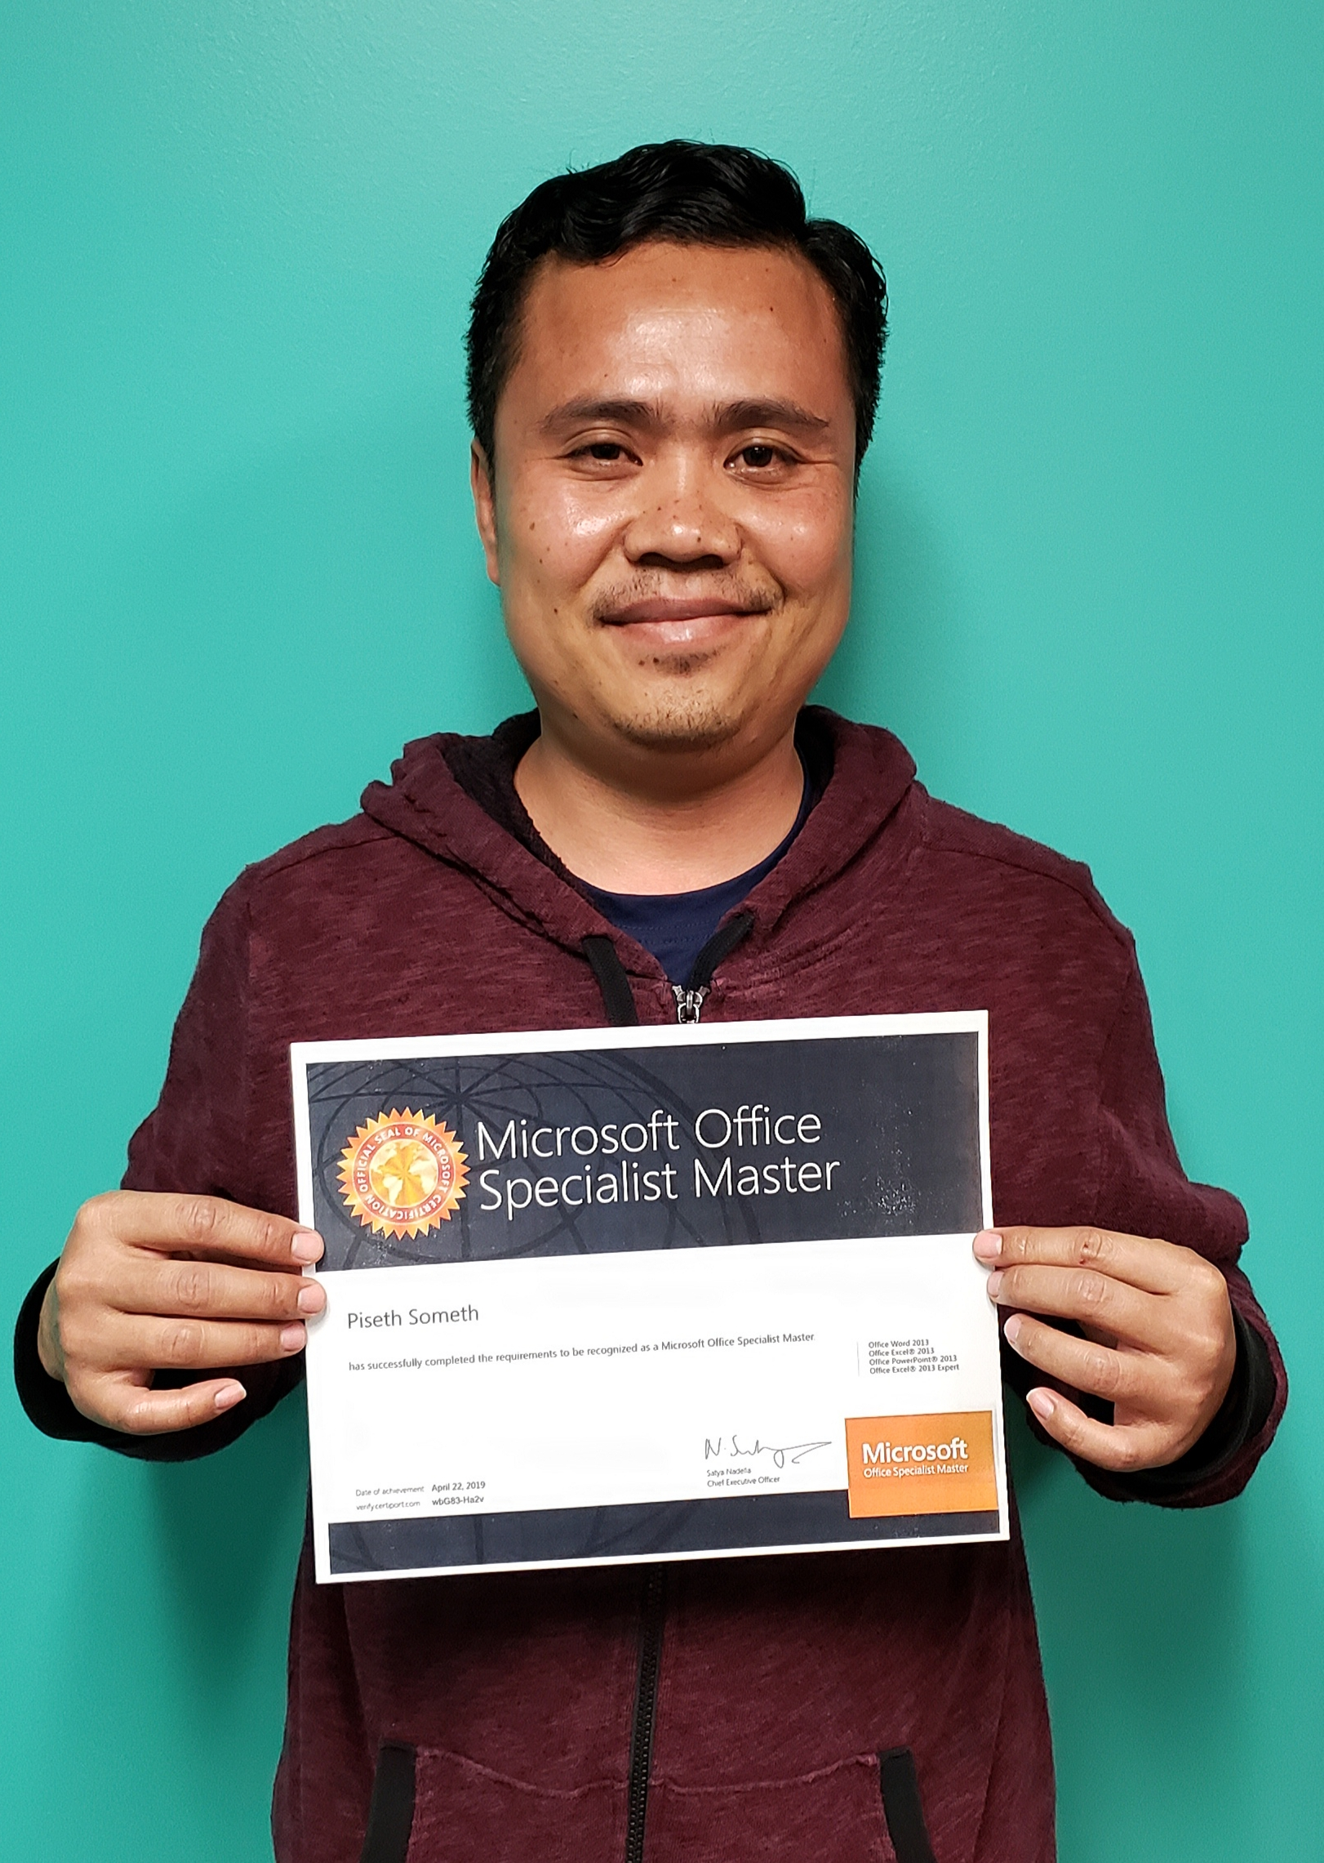
Got Any Success Stories?
Recently, we had one of our participants get a perfect score on her Word 2016 exam!
Moreover, in 2020 we’ve had 27 successful certifications across all the programs.
Since the program started in 2016, there have been 218 certifications across the programs.
This is Piseth. He is the first ever (that we know of) Kansas Workforce customer to gain a Master Certification!

Slide 15
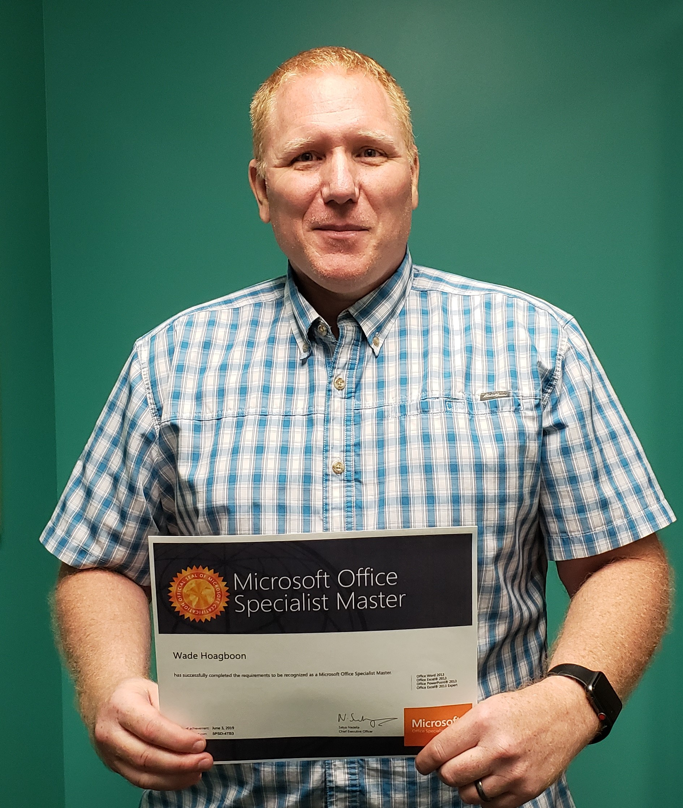
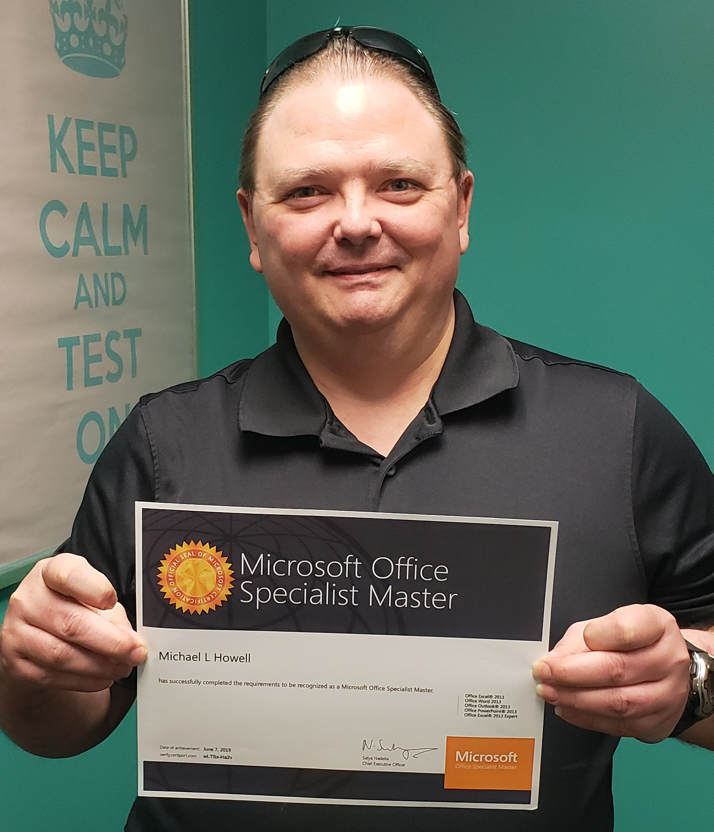
More Success Stories
Since Piseth led the way, we have had a total of 8 individuals obtain their MOS Master certifications, with more in the process. This is Wade and Michael, 2 of our other Master recipients.
Several of our recipients have received employment related to their certifications or are pursuing further training through a partner program.

Slide 16
Where Can I Find More Info?
Check out the Imagine Academy page on the Workforce Center’s website: http://workforce-ks.com/imagine-academy/
Imagine Academy is also in the “Quick Links” tab on the website
Check out the Imagine Academy flyer, protocols, and other resources by searching “Imagine Academy” on the Intranet
Email Dawn and me at iacademy@workforce-ks.com
All questions, concerns, and referrals (either formal or informal) should go to that email. We both have access to it; if one of us is out the other can address any immediate questions or needs

Slide 17
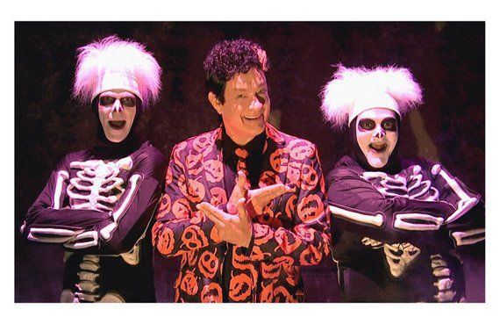
Any Questions?

